Slide 1
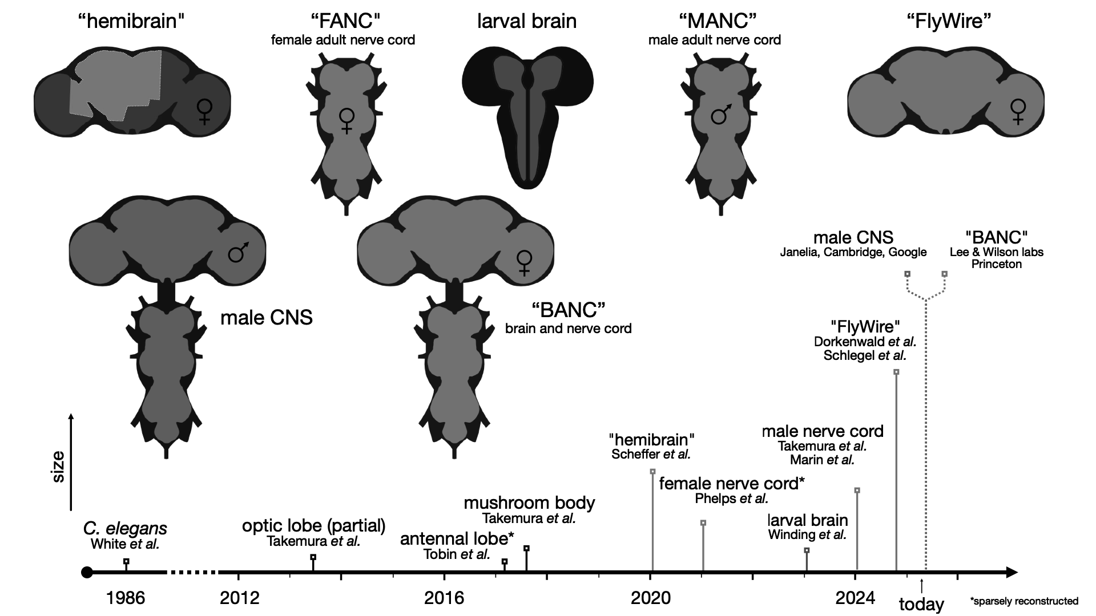
connectomes so far
Philipp Schlegel

Slide 2
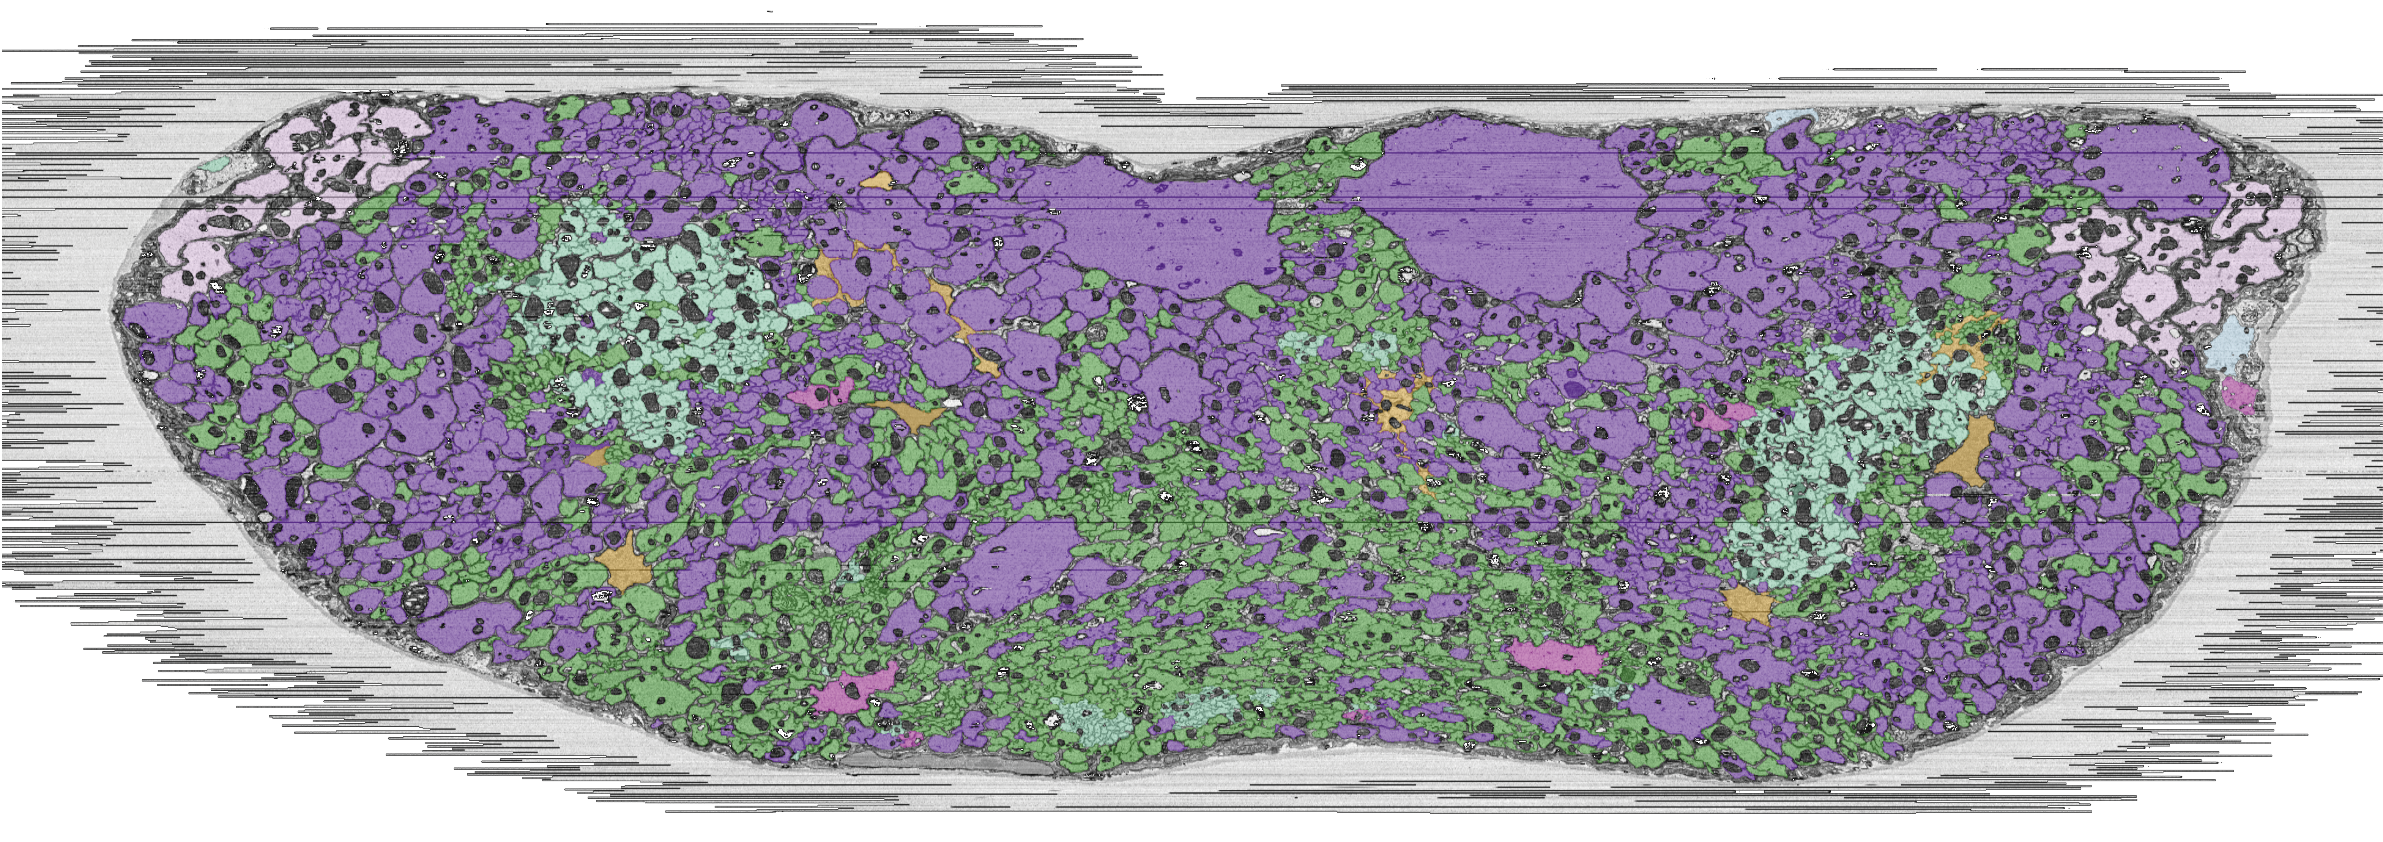
transection of the neck connective
descending neurons
ascending neurons

Slide 3
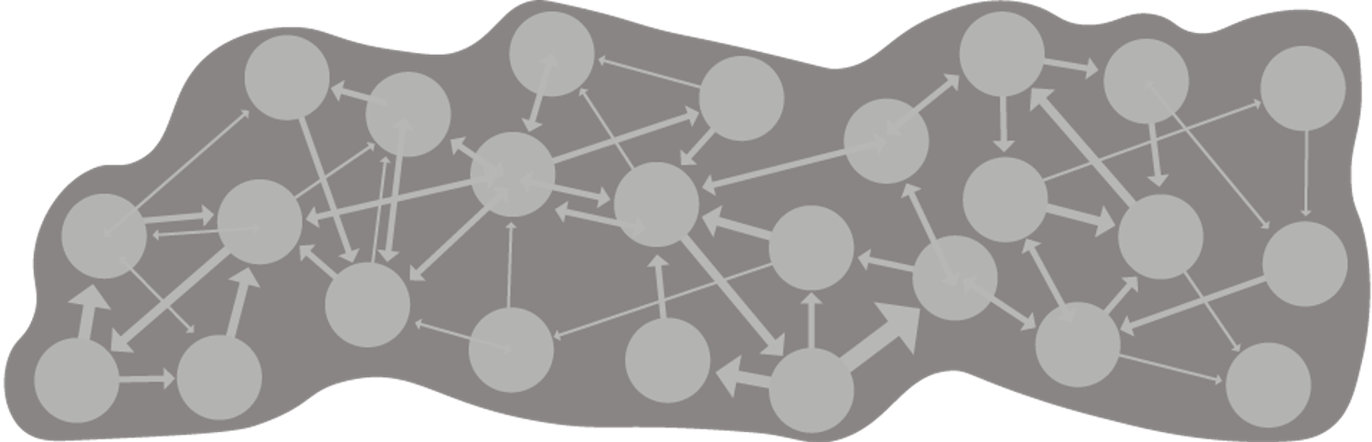
turning raw EM data into a useful connectome
a
b
all the neurons in the central nervous system reconstructed (~160k)
synapses detected across the whole volume (~20-100M)
essential

Slide 4
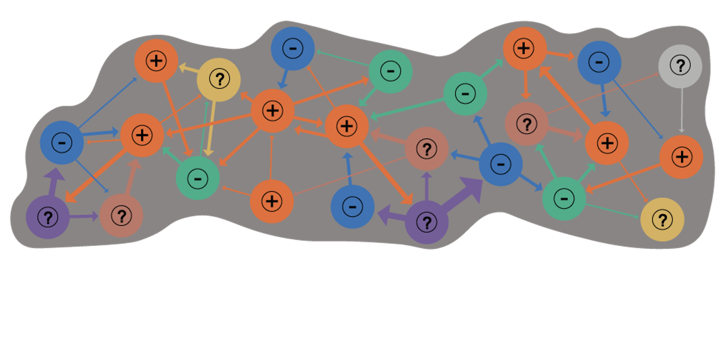
turning raw EM data into a useful connectome
e
classification
i.e. literature-consistent cell types
c
network signs
i.e. neurotransmitter predictions
d
other detections
e.g. neuropeptides
ideal

Slide 5
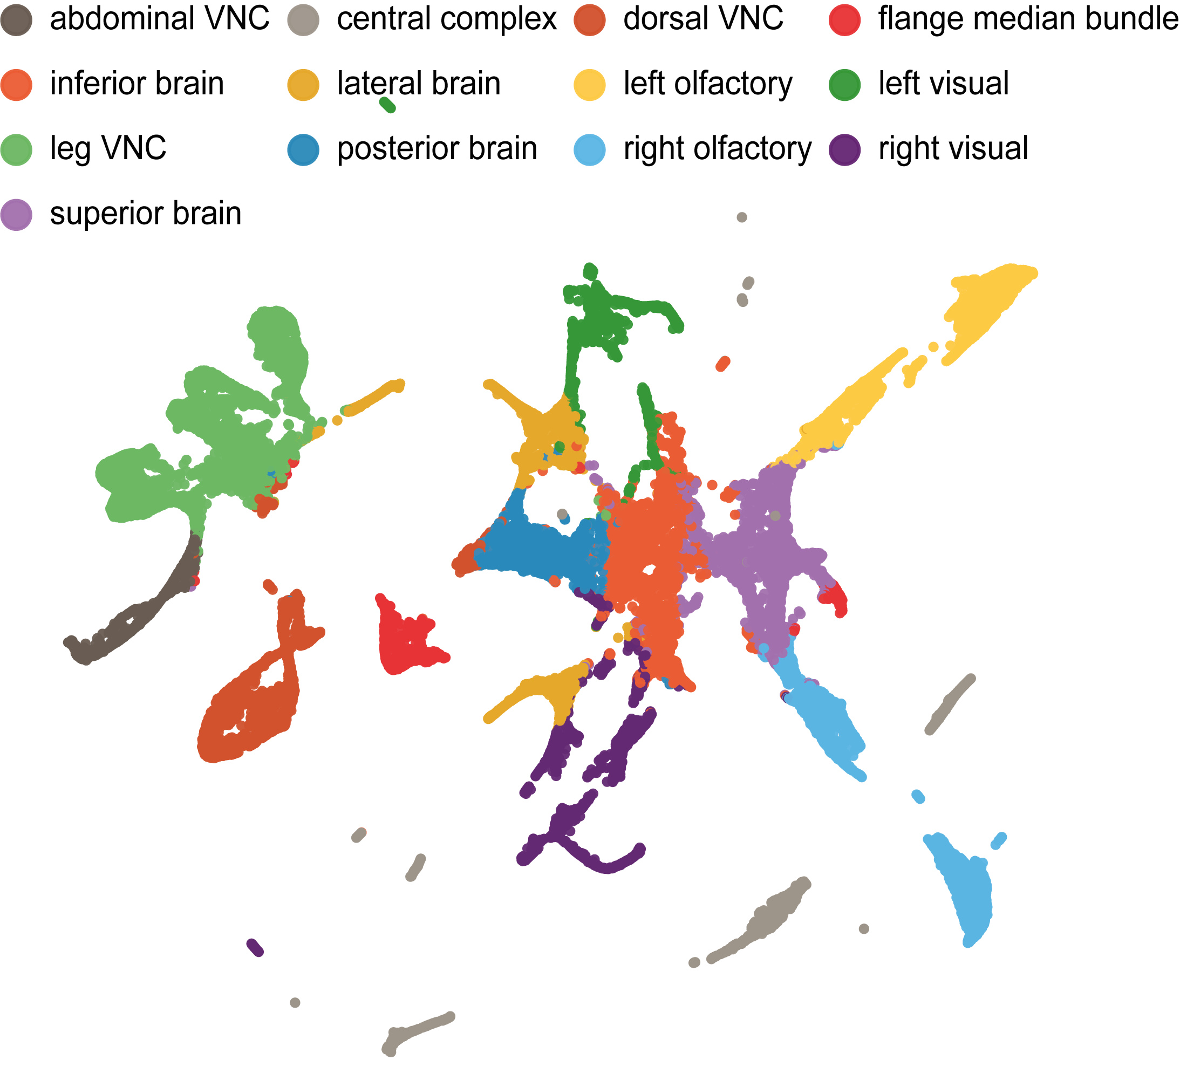
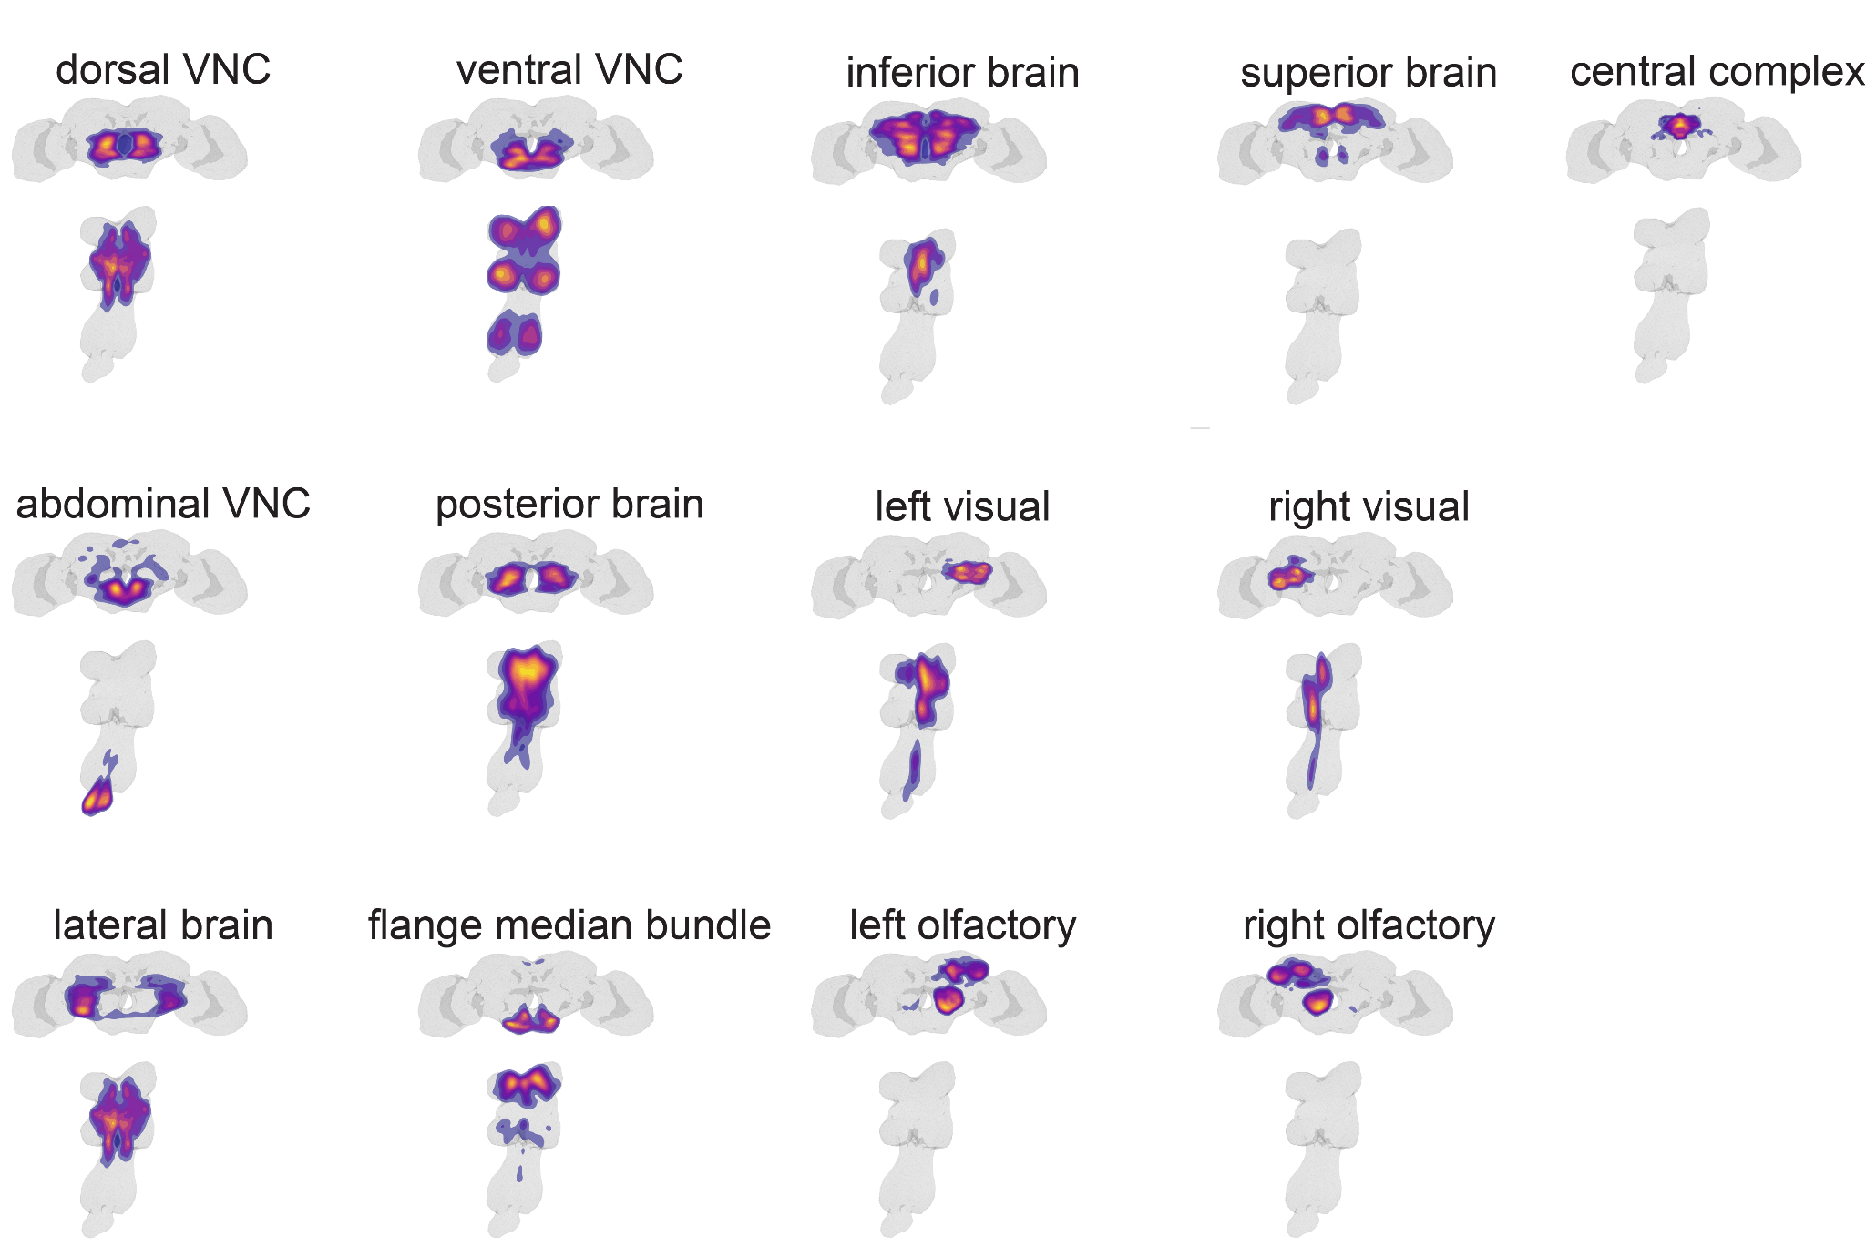
clustering neurons across the CNS
Notes:
What about the rest of the central nervous system?
To look at this, we used spectral clustering to divide the central nervous system into 13 discrete networks of interconnected neurons, shown here. Briefly, like we modularized the ANs and DNs earlier, here, we modularized the central nervous system by trying to maximize the connectivity within each of these networks while minimizing connectivity across networks. These define candidate coarse functional divisions. Interestingly, like with the AN/DN superclusters these networks strongly influence effectors and, there’s a hierarchical pattern of connectivity between these networks. At this broader scale, the nervous system again resembles a subsumption architecture. The central complex and olfactory system stand out. They don’t strongly influence effectors and instead largely provide input to other networks, as if they’re towards the top of a subsumption hierarchy.

Slide 6
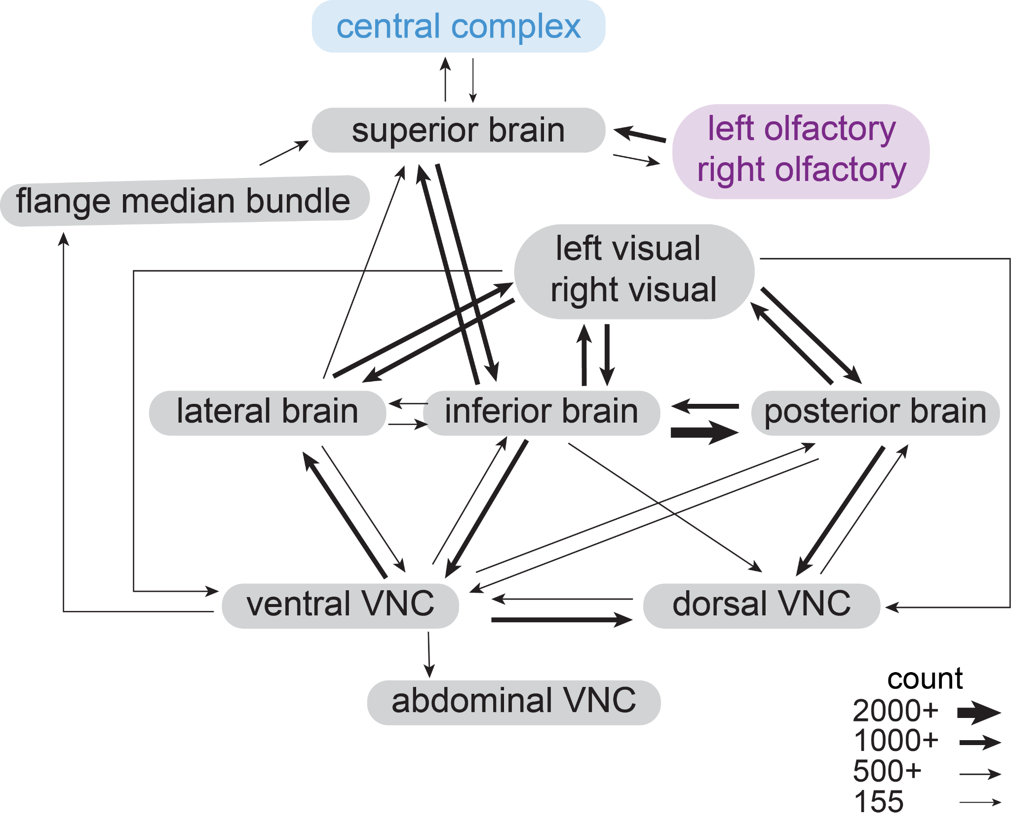
general overview of the CNS
Notes:
What about the rest of the central nervous system?
To look at this, we used spectral clustering to divide the central nervous system into 13 discrete networks of interconnected neurons, shown here. Briefly, like we modularized the ANs and DNs earlier, here, we modularized the central nervous system by trying to maximize the connectivity within each of these networks while minimizing connectivity across networks. These define candidate coarse functional divisions. Interestingly, like with the AN/DN superclusters these networks strongly influence effectors and, there’s a hierarchical pattern of connectivity between these networks. At this broader scale, the nervous system again resembles a subsumption architecture. The central complex and olfactory system stand out. They don’t strongly influence effectors and instead largely provide input to other networks, as if they’re towards the top of a subsumption hierarchy.

Slide 7
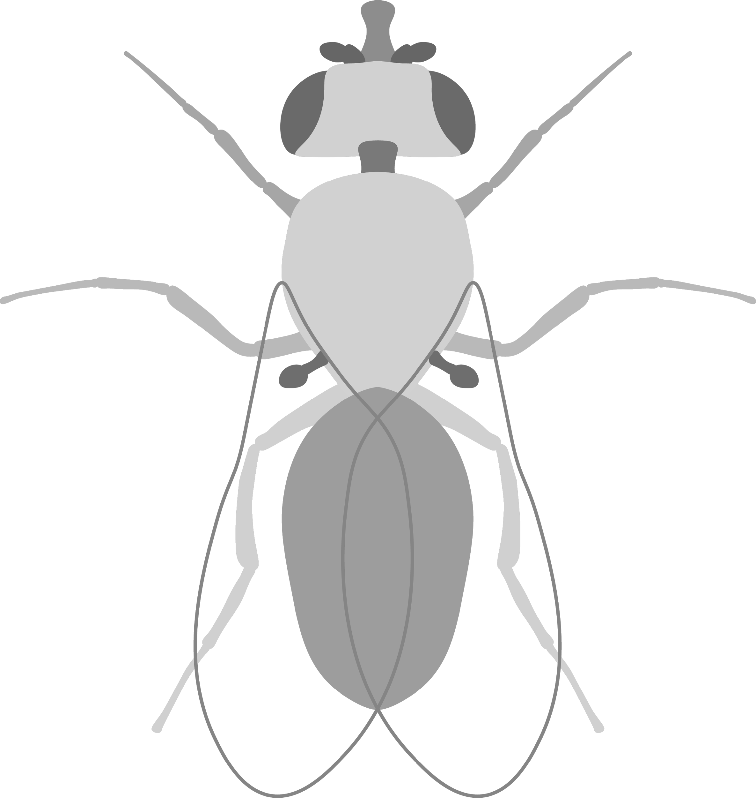


antenna
motor: 10
sensory: 3264
modalities: olfaction, vibration, deflection,
thermosensation
hygrosensation
proboscis
motor: 58 (moving, ingesting)
sensory: 58
modalities: gustation, tactile
other: retrocerebral complex, neurohemal organ, heart, crop
endocrine: ~90 (systemic hormones, internal organs)
motor: ~90
sensory: unknown
eye
motor: 4
sensory: 1,110
modalities: chromatic vision, achromatic vision, UV, polarised
abdomen
motor: 195 (mating, movement, defecation, breathing, GI)
endocrine: 34
sensory: 1008
modalities: proprioception,
vibration, tactile, nociception, gustation
legs (front, middle, hind)
motor: 396
sensory: 3678
modalities: proprioception,
vibration, tactile, nociception, gustation
wings
motor: 82 (pivot, power, resonance)
sensory: 989
modalities: proprioception,
vibration, tactile, nociception, gustation
halteres
motor: 16 (pivot, power)
sensory: 636
modalities: proprioception, respiration,
Anthony Azevedo, Helen Yang, Meet Zandawala, Stefanie Hampel, Andrew Seeds, Serene Dhawan, Sweta Agrawal, + more

Slide 8
antenna
motor: 10
sensory: 3264
modalities: olfaction, vibration, deflection,
thermosensation
hygrosensation
proboscis
motor: 58 (moving, ingesting)
sensory: 58
modalities: gustation, tactile
other: retrocerebral complex, neurohemal organ, heart, crop
endocrine: ~90 (systemic hormones, internal organs)
motor: ~90
sensory: unknown
meta: cell_class cell_sub_class body_part_effector body_part_sensory
eye
motor: 4
sensory: 1,110
modalities: chromatic vision, achromatic vision, UV, polarised
abdomen
motor: 195 (mating, movement, defecation, breathing, GI)
endocrine: 34
sensory: 1008
modalities: proprioception,
vibration, tactile, nociception, gustation
legs (front, middle, hind)
motor: 396
sensory: 3678
modalities: proprioception,
vibration, tactile, nociception, gustation
wings
motor: 82 (pivot, power, resonance)
sensory: 989
modalities: proprioception,
vibration, tactile, nociception, gustation
halteres
motor: 16 (pivot, power)
sensory: 636
modalities: proprioception, respiration,
Anthony Azevedo, Helen Yang, Meet Zandawala, Stefanie Hampel, Andrew Seeds, Serene Dhawan, Sweta Agrawal, + more

Slide 9
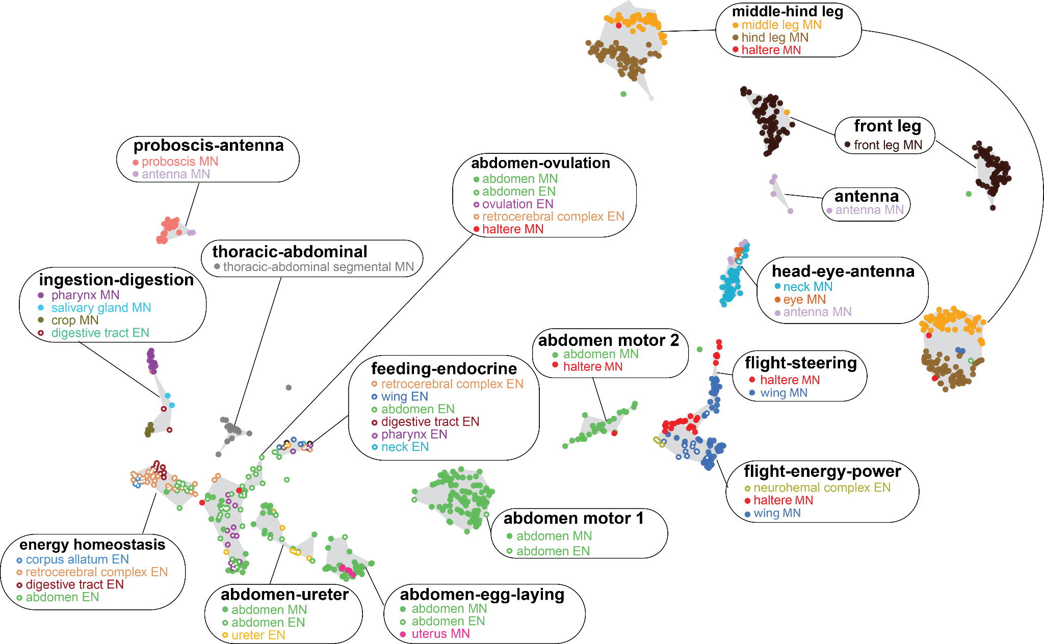
common upstream partners define sets of effectors
Notes:
Here, took all effector neurons and clustered them based on the similarity of their influence from all ANs and DNs. Form sets of co-regulated motor and endocrine neurons. In groups that suggest coordinated output. Again, these can be long-range. E.g. flight-energy-power cluster
We turned to examine ANs and DNs more directly and looked at how they’re influenced by sensors and how they influence effectors

Slide 10
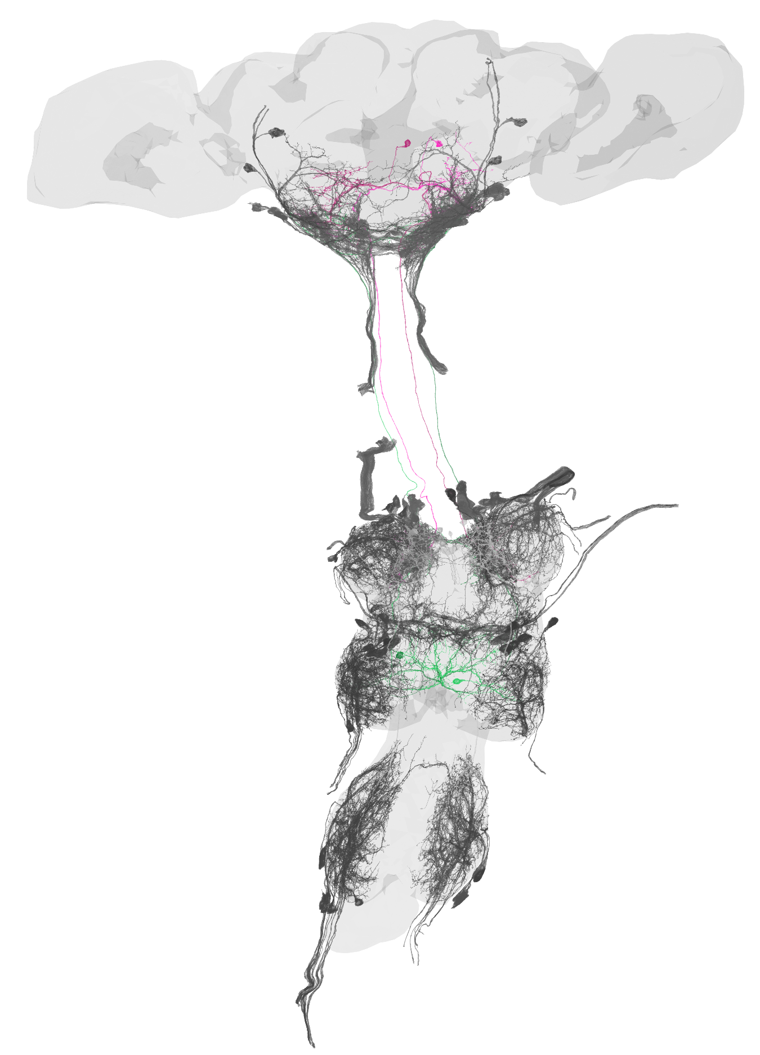
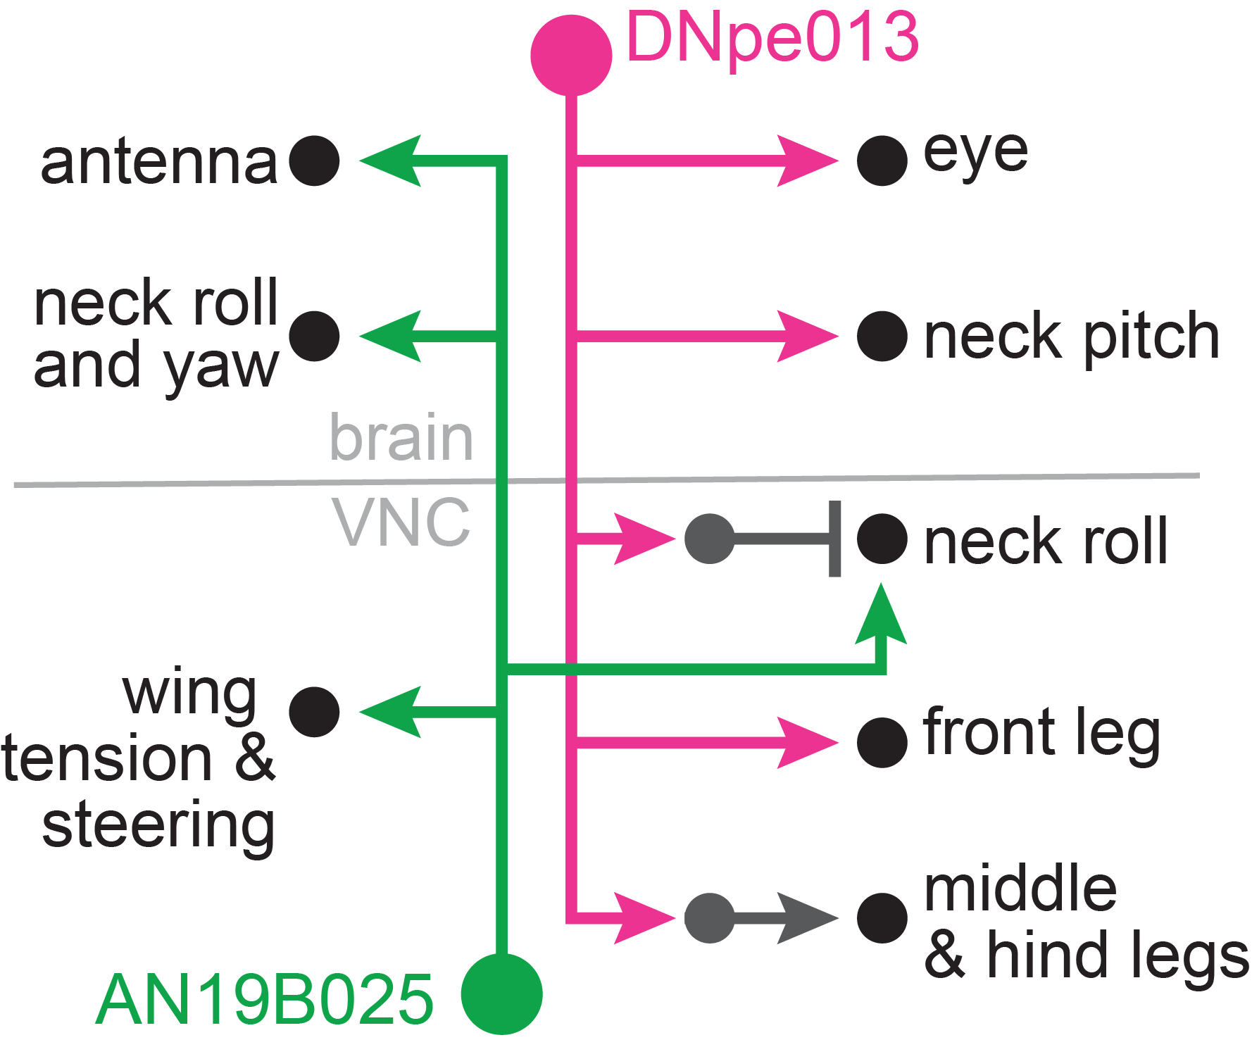
ascending and descending neurons link effectors across the body
circuit: directing the body
Notes:
Indeed, there are ANs and DNs that link effectors across the body. For example, two cell types, one AN, one DN, that link motor neurons controlling multiple body parts, even when we only consider mono- and di-synaptic connections. DN for eye, neck, leg motor neurons. AN antenna, neck, wing motor neurons
These cells define sets of co-controlled motor neurons.
We find that this is more broadly true across effectors and ANs and DNs

Slide 11
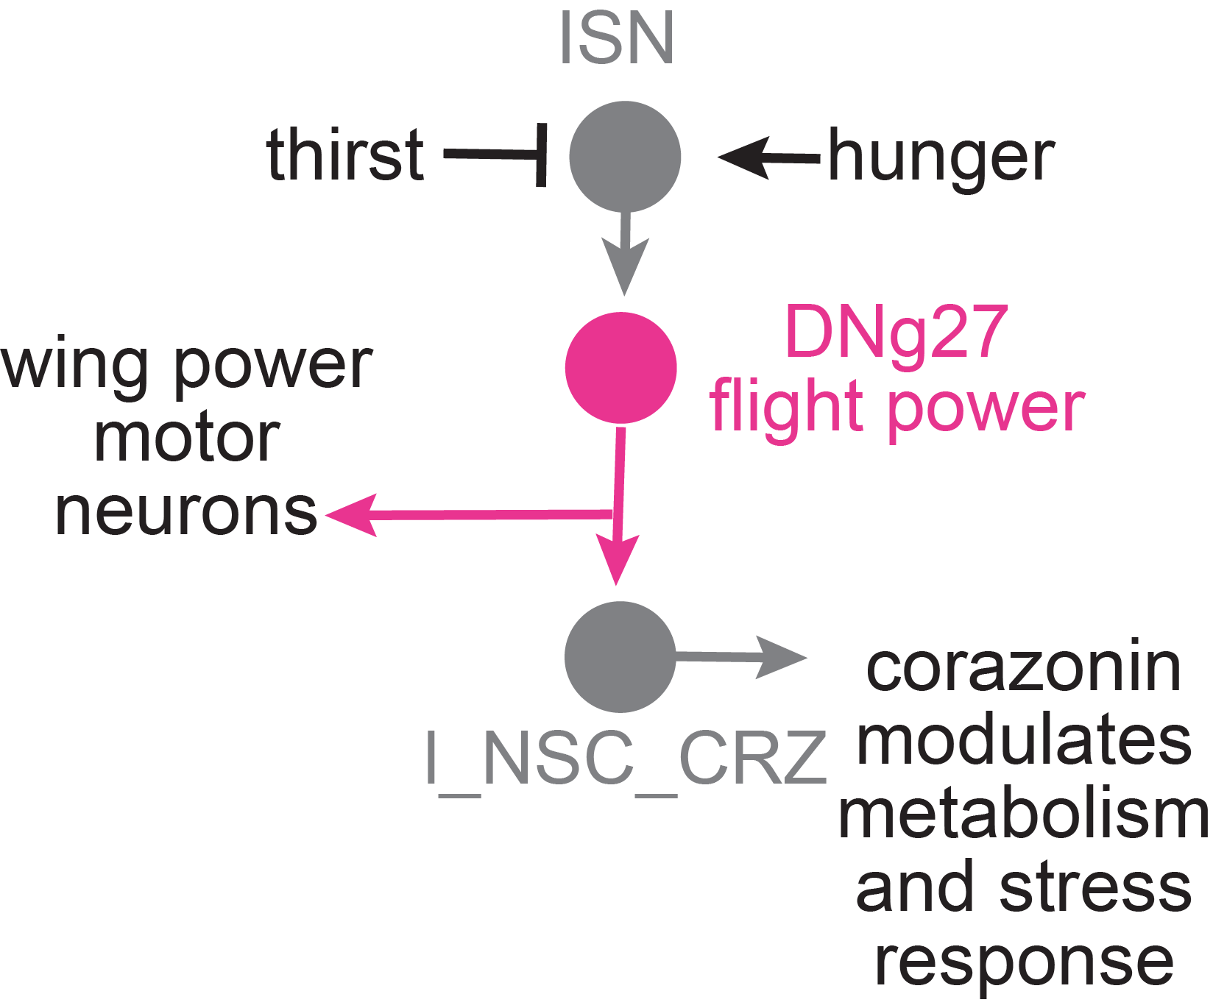
circuit: co-regulation of flight power and endocrine stress response
Notes:
Example of member of flight power supercluster, which directly synapses onto the wing power motor neurons
Interestingly, also targets brain endocrine neurons that release corazonin, which is a neuropeptide that mobilizes energy stores. So DNg27 might not only directly increase flight power but also release the energy stores needed to sustain flight. And one of the stimuli it might use to determine flight power is water balance, again important for an energetically demanding behavior, as it gets input from interoceptive neurons that are suppressed by thirst

Slide 12
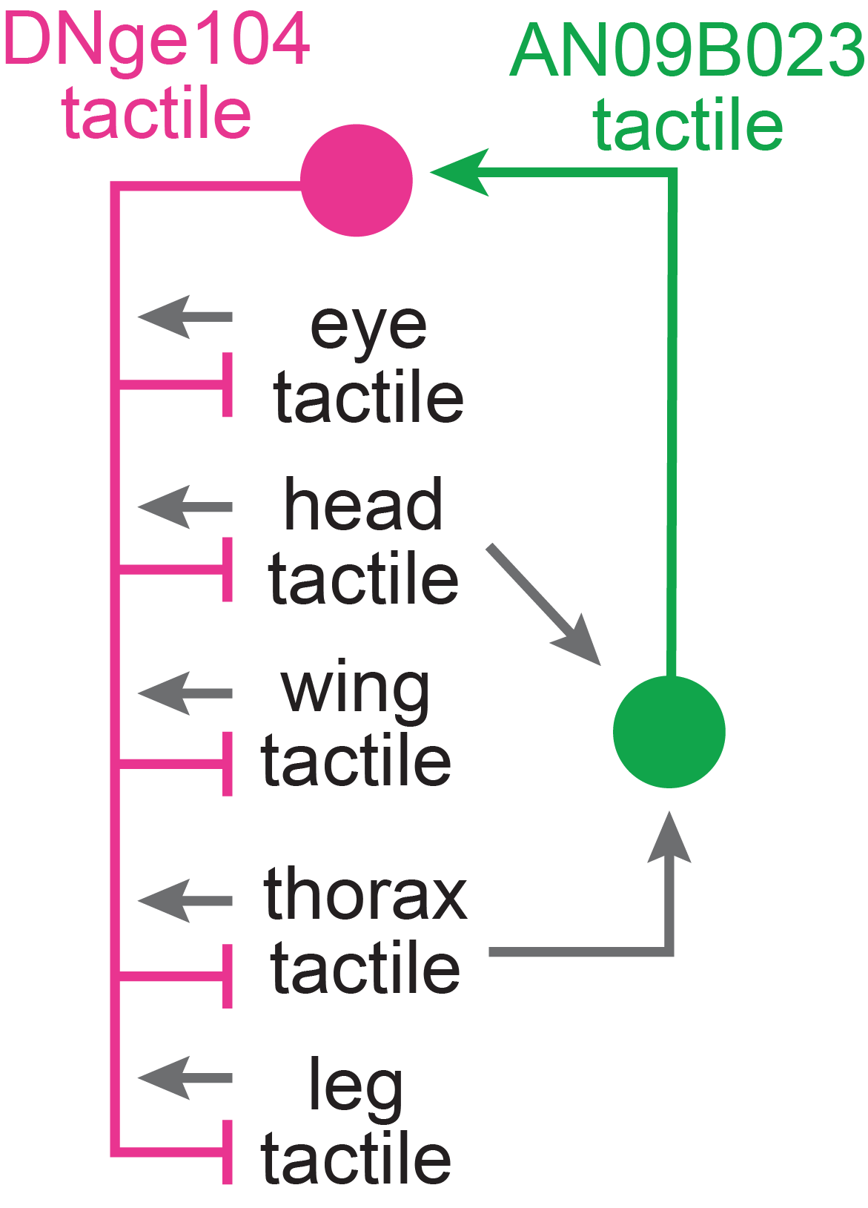
circuit: sensory contrast enhancement
Notes:
Example of DNge104 gets input from tactile sensors across the body and then inhibits those same sensors. Perhaps does tactile contrast enhancement. E.g. through AN of the same supercluster that receives input from a subset of these sensors.

Slide 13
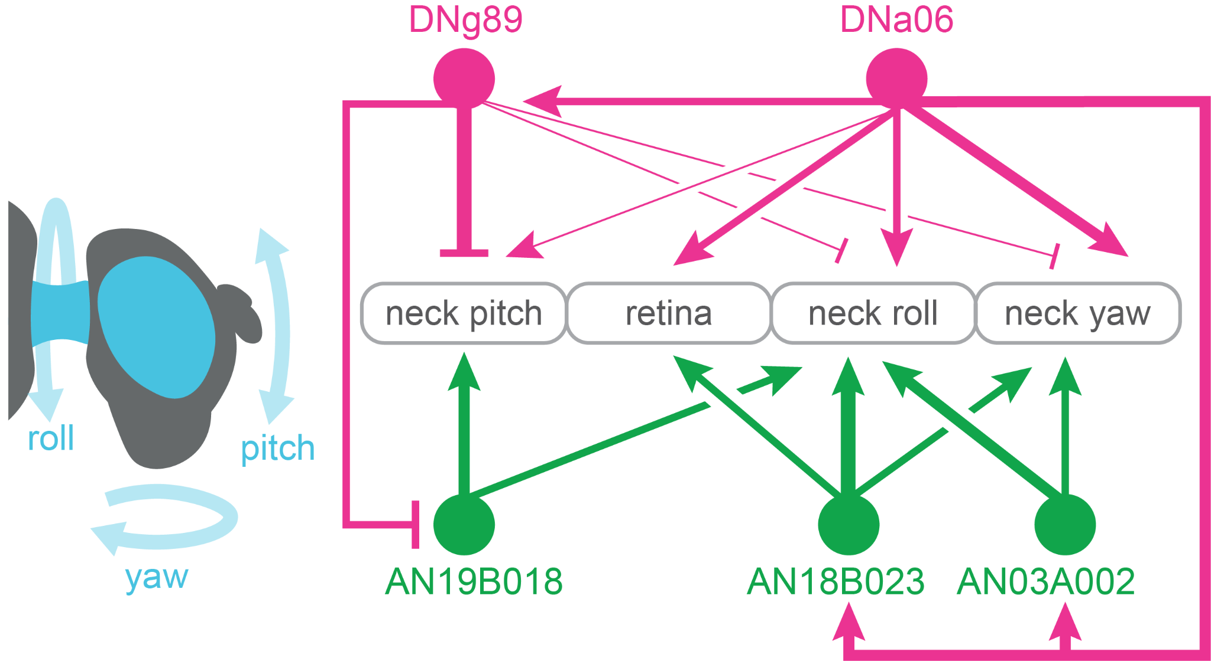
circuit: pitching, rolling and yawing the neck
Notes:
For example, there’s this circuit that seems to control overlapping but distinct combinations of neck and eye movements.
Motor neurons in middle here. These descending and ascending neurons seem to promote neck roll and yaw more than pitch. But only some also move the eye. And this one would promote neck roll and yaw but it seems to do so by mostly inhibiting pitch. And this other ascending neuron instead drives neck pitch and roll.
Seems like members of the same supercluster define fine-grained variations of the broader overarching behavior. Could promote flexibility

Slide 14
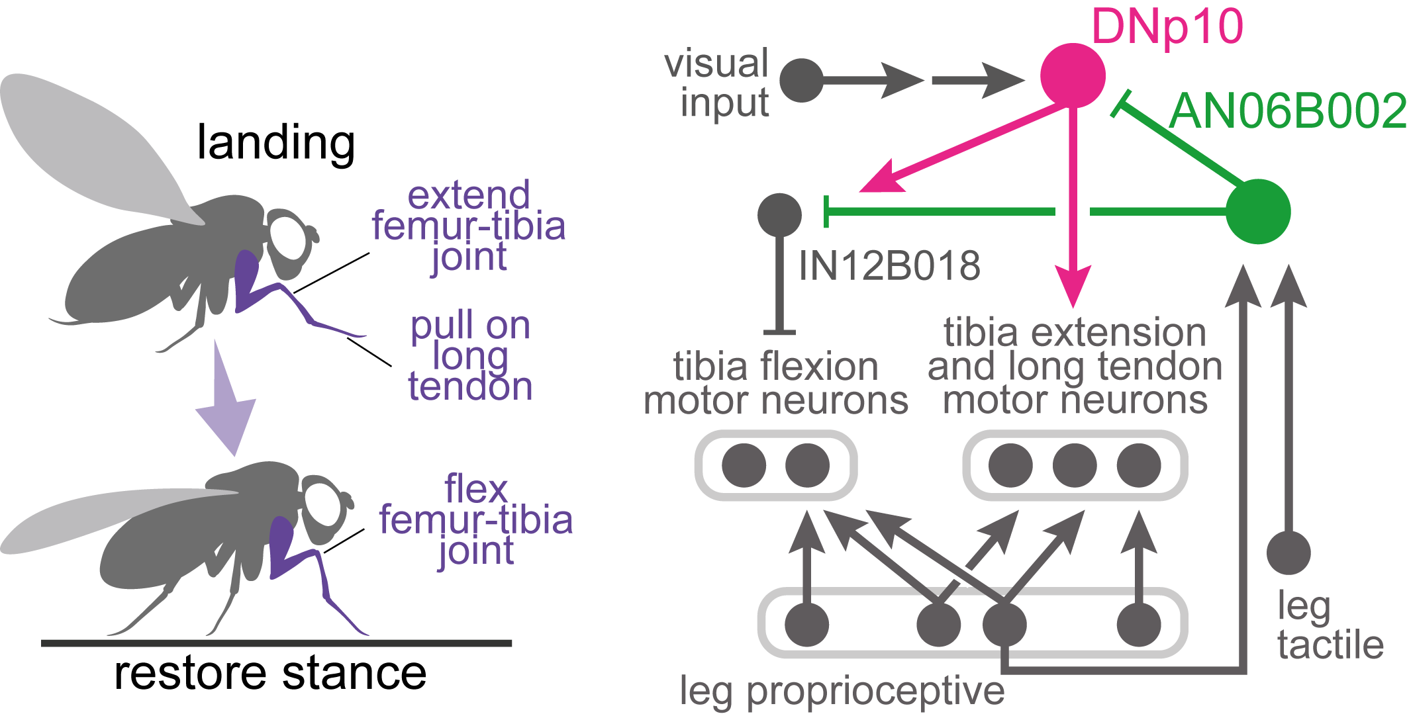
circuit: landing
Notes:
For example, there’s this circuit that seems to control overlapping but distinct combinations of neck and eye movements.
Motor neurons in middle here. These descending and ascending neurons seem to promote neck roll and yaw more than pitch. But only some also move the eye. And this one would promote neck roll and yaw but it seems to do so by mostly inhibiting pitch. And this other ascending neuron instead drives neck pitch and roll.
Seems like members of the same supercluster define fine-grained variations of the broader overarching behavior. Could promote flexibility

Slide 15
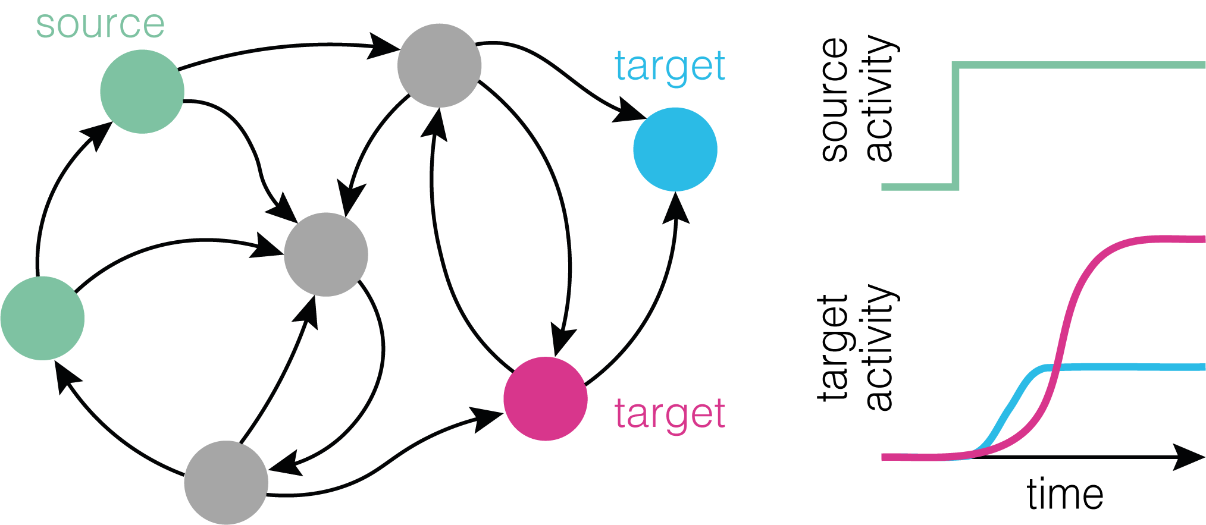


The "influence" score
https://github.com/DrugowitschLab/ConnectomeInfluenceCalculator
https://github.com/natverse/influencer

Slide 16
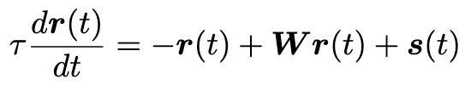
linear dynamical model
time constant
external input (Seed)
(160,000 x 1)
neural activity
(160,000 x 1)
connectivity matrix
(160,000 x 160,000)

Slide 17
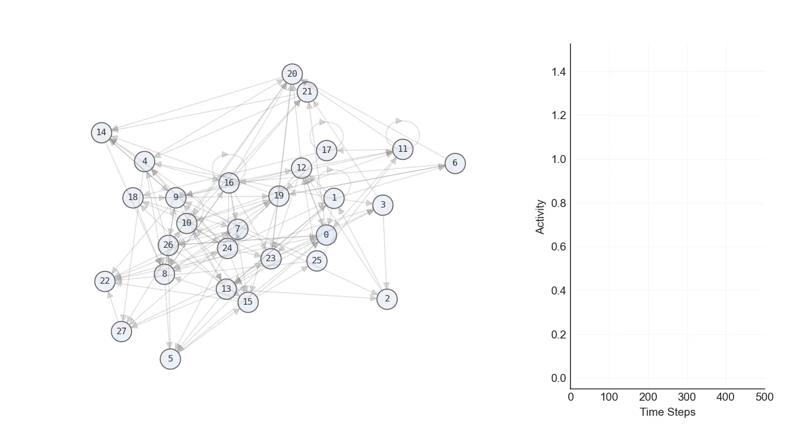
linear dynamical model
0
Steady-state
∞
Notes:
Use same network as before

Slide 18
linear dynamical model
pros:
cons:
Efficient and fast computation (~25 billion influence scores computed in less than 20 hours)
Covers all possible pathways
Additive method
Simplistic model
All synapse types are treated as excitatory
this is not a biophysical model
Notes:
Pros:
Covers all possible pathways between seed and target (well adapted for an exploratory study)
Additive method (allows summing influence score from different seeds and combining them into more complex seeds)
Allows silencing specific neurons to analyze their impact on particular pathways
Efficient and fast computation (~25 billion influence scores computed in less than 20 hours)
Cons:
Simplistic model
All synapses are treated equally (no difference between excitatory and inhibitory signaling)

Slide 19
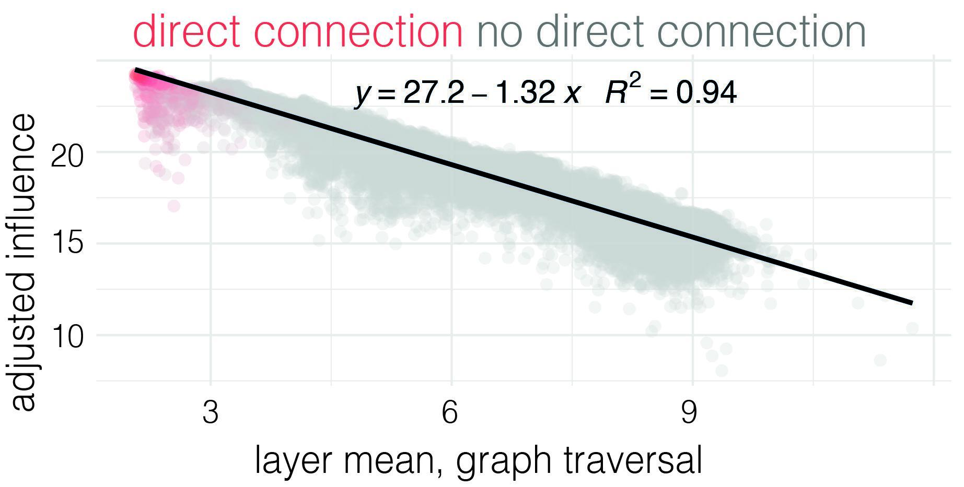
methods for interpreting the connectome
Schlegel and Bates et al., 2021

Slide 20
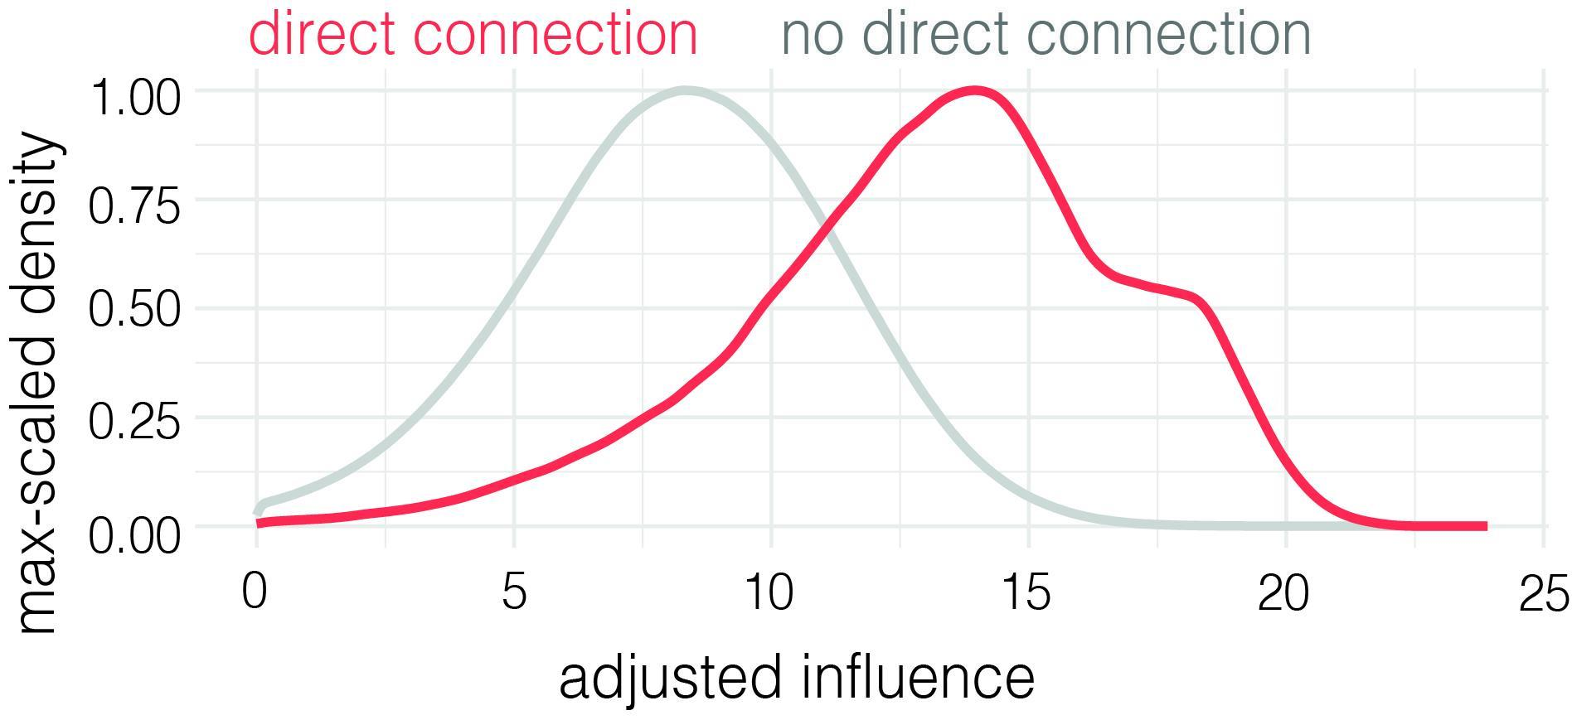
methods for interpreting the connectome

Slide 21
antenna
motor: 10
sensory: 3264
modalities: olfaction, vibration, deflection,
thermosensation
hygrosensation
proboscis
motor: 58 (moving, ingesting)
sensory: 58
modalities: gustation, tactile
other: retrocerebral complex, neurohemal organ, heart, crop
endocrine: ~90 (systemic hormones, internal organs)
motor: ~90
sensory: unknown
eye
motor: 4
sensory: 1,110
modalities: chromatic vision, achromatic vision, UV, polarised
abdomen
motor: 195 (mating, movement, defecation, breathing, GI)
endocrine: 34
sensory: 1008
modalities: proprioception,
vibration, tactile, nociception, gustation
legs (front, middle, hind)
motor: 396
sensory: 3678
modalities: proprioception,
vibration, tactile, nociception, gustation
wings
motor: 82 (pivot, power, resonance)
sensory: 989
modalities: proprioception,
vibration, tactile, nociception, gustation
halteres
motor: 16 (pivot, power)
sensory: 636
modalities: proprioception, respiration,
Anthony Azevedo, Helen Yang, Meet Zandawala, Stefanie Hampel, Andrew Seeds, Serene Dhawan, Sweta Agrawal, + more

Slide 22
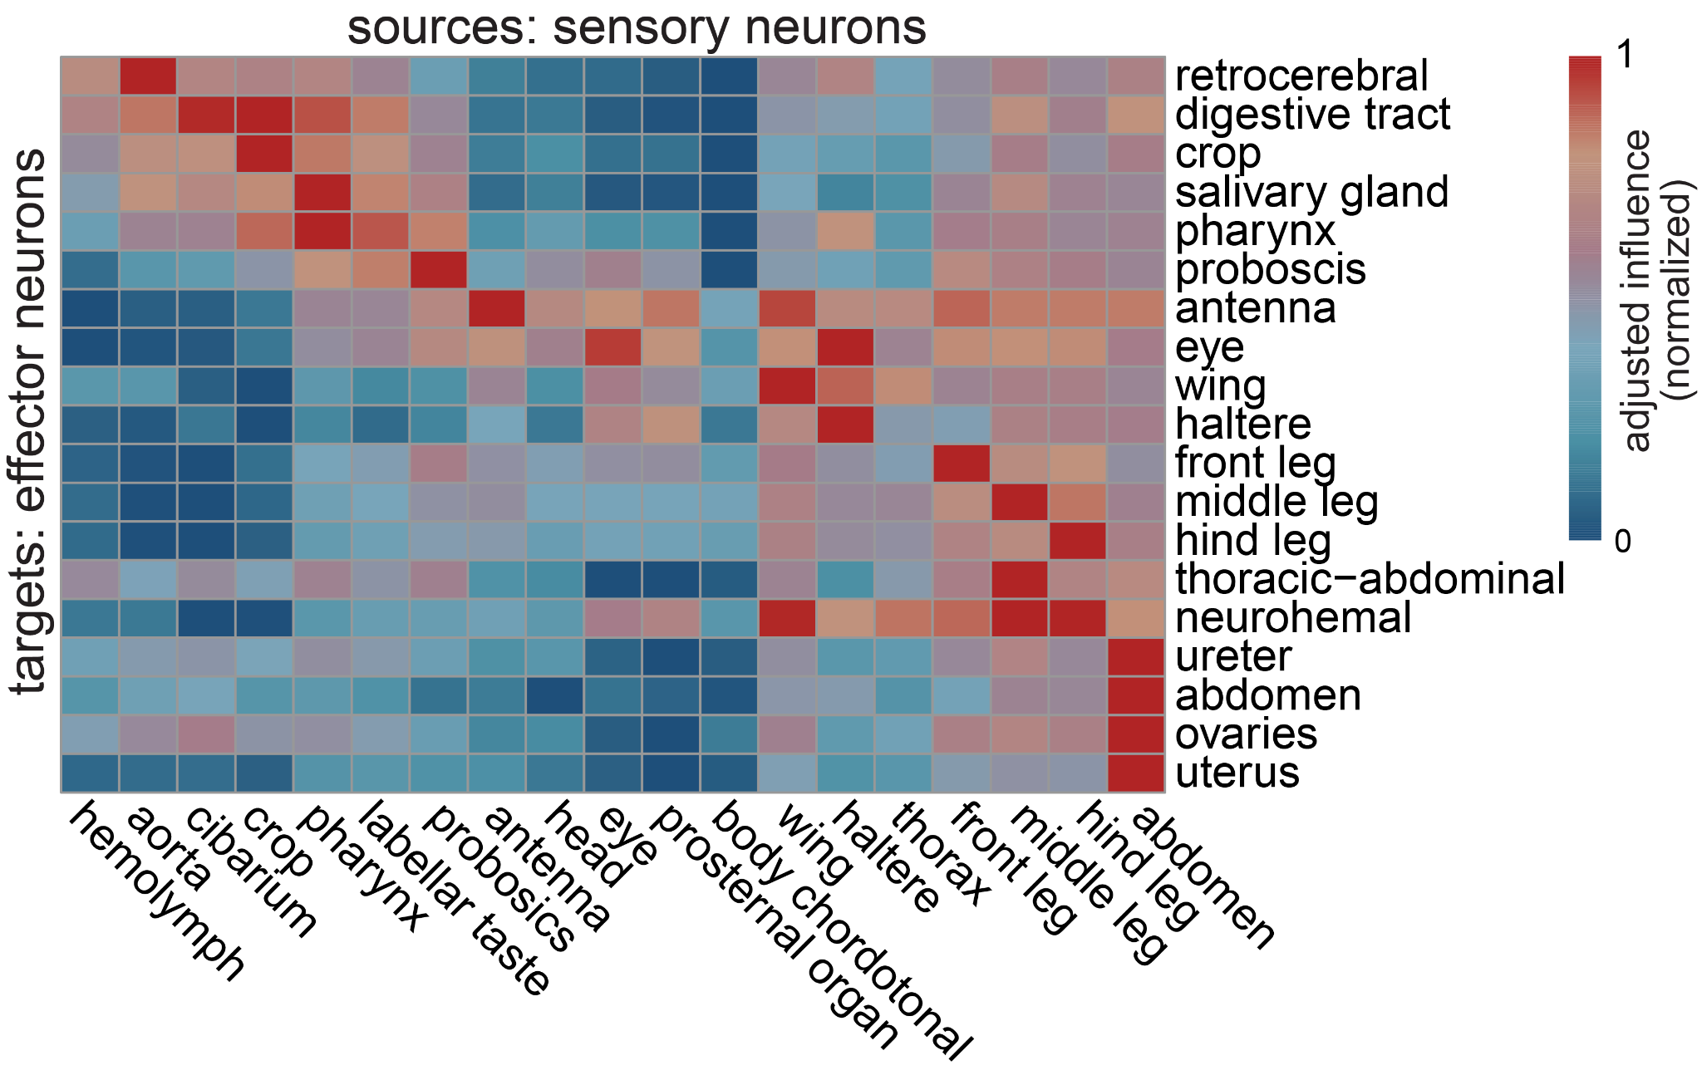
sensors mainly influence effectors of the same body part
but there is also long-range influence

Slide 23
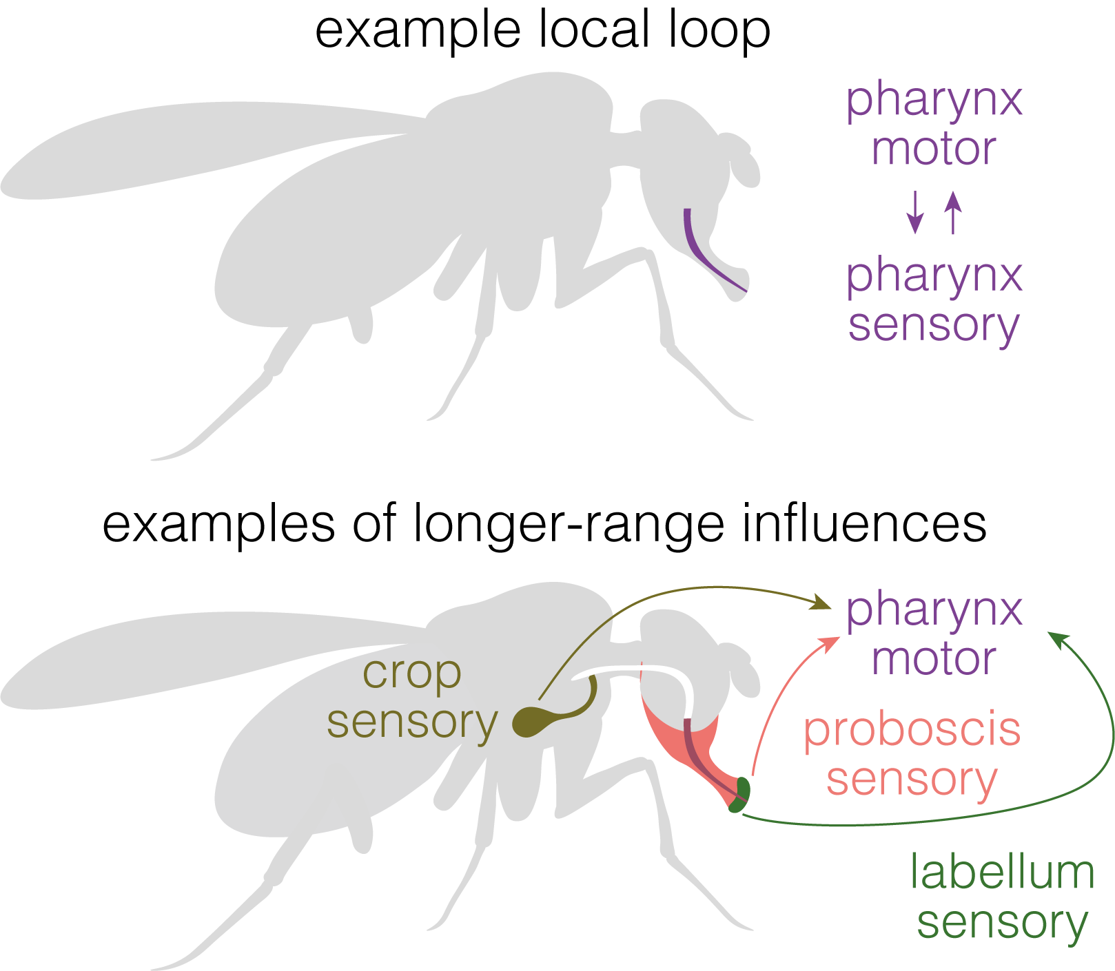
sensors mainly influence effectors of the same body part
but there is also long-range influence
Notes:
Alex showed you this heatmap previously. One of the first things we did was to look at how sensory neurons from different parts of the body influenced effector neurons (i.e. motor and endocrine neurons).
Strongest influence onto effector neurons sensory neurons of same body part. Represent local feedback loops. E.g. antenna motor neurons strongest influence from sensory neurons of antenna.
However, there’s also a lot of sensory influence from more distant body parts. E.g. antenna, particularly from wing, front leg, prosternal organ. Off diagonal pink across matrix.
Suggests local loops linked by long-range connections. Often, long range influences bridge the neck. Antenna on head and motor neurons in brain, but wing, front leg, prosternal influence all from body through VNC. ANs and DNs are the neurons that bridge the neck

Slide 24
sensors mainly influence effectors of the same body part
but there is also long-range influence
Notes:
Alex showed you this heatmap previously. One of the first things we did was to look at how sensory neurons from different parts of the body influenced effector neurons (i.e. motor and endocrine neurons).
Strongest influence onto effector neurons sensory neurons of same body part. Represent local feedback loops. E.g. antenna motor neurons strongest influence from sensory neurons of antenna.
However, there’s also a lot of sensory influence from more distant body parts. E.g. antenna, particularly from wing, front leg, prosternal organ. Off diagonal pink across matrix.
Suggests local loops linked by long-range connections. Often, long range influences bridge the neck. Antenna on head and motor neurons in brain, but wing, front leg, prosternal influence all from body through VNC. ANs and DNs are the neurons that bridge the neck

Slide 25
sensors mainly influence effectors of the same body part
but there is also long-range influence
Notes:
Alex showed you this heatmap previously. One of the first things we did was to look at how sensory neurons from different parts of the body influenced effector neurons (i.e. motor and endocrine neurons).
Strongest influence onto effector neurons sensory neurons of same body part. Represent local feedback loops. E.g. antenna motor neurons strongest influence from sensory neurons of antenna.
However, there’s also a lot of sensory influence from more distant body parts. E.g. antenna, particularly from wing, front leg, prosternal organ. Off diagonal pink across matrix.
Suggests local loops linked by long-range connections. Often, long range influences bridge the neck. Antenna on head and motor neurons in brain, but wing, front leg, prosternal influence all from body through VNC. ANs and DNs are the neurons that bridge the neck

Slide 26
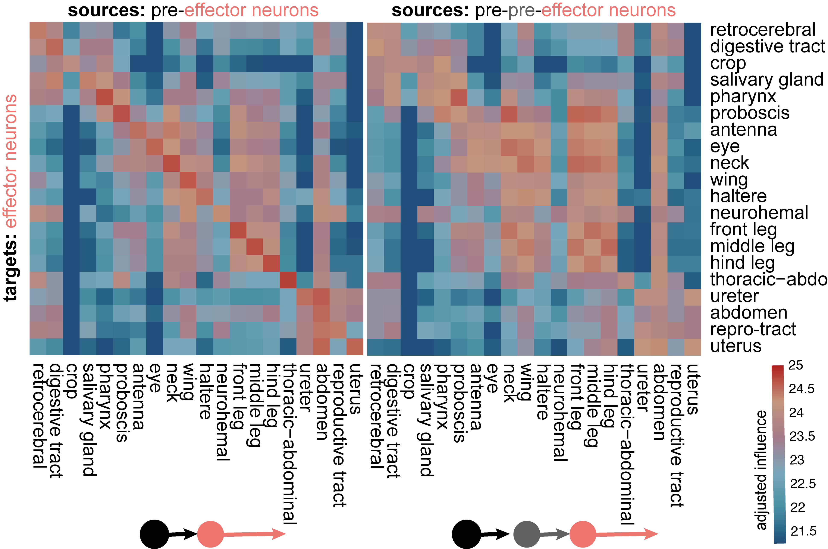
effector neurons have local circuits that are chained at higher levels
Notes:
Here, we’ve embedded all the ANs and DNs based on their direct pre- and postsynaptic connections. Then, on top, can overlay influence from different sets of sensory neurons

Slide 27
effector neurons have local circuits that are chained at higher levels
Notes:
Here, we’ve embedded all the ANs and DNs based on their direct pre- and postsynaptic connections. Then, on top, can overlay influence from different sets of sensory neurons

Slide 28
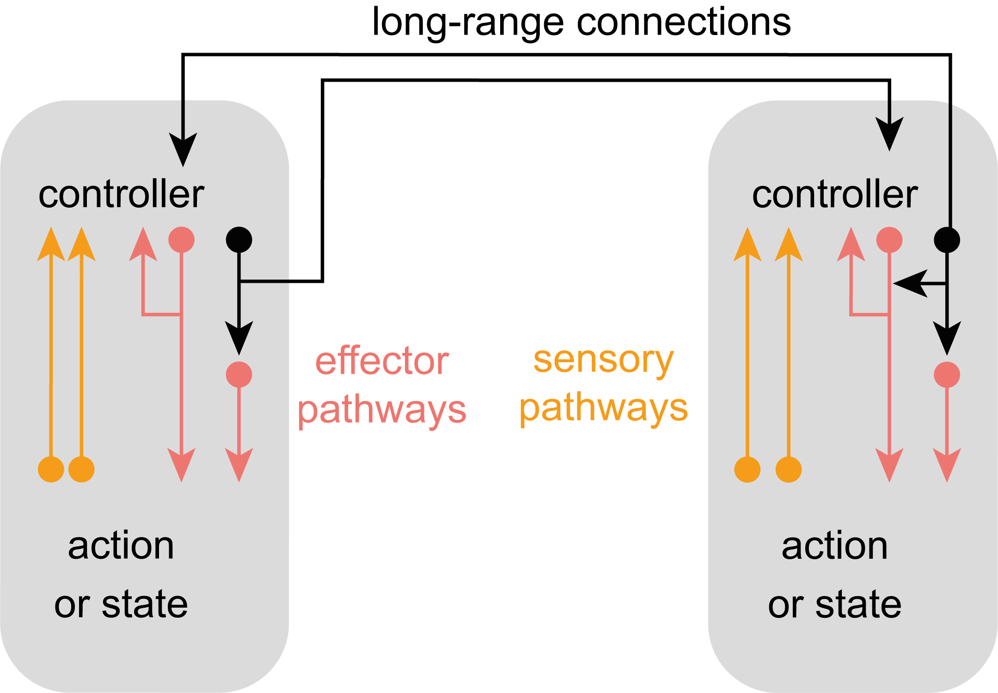
effector neurons have local circuits that are chained at higher levels
Notes:
Here, we’ve embedded all the ANs and DNs based on their direct pre- and postsynaptic connections. Then, on top, can overlay influence from different sets of sensory neurons

Slide 29
long-ranged connections transfer sensorimotor information across the CNS
descending neurons
ascending neurons

Slide 30
common upstream partners define sets of effectors
Notes:
Here, took all effector neurons and clustered them based on the similarity of their influence from all ANs and DNs. Form sets of co-regulated motor and endocrine neurons. In groups that suggest coordinated output. Again, these can be long-range. E.g. flight-energy-power cluster
We turned to examine ANs and DNs more directly and looked at how they’re influenced by sensors and how they influence effectors

Slide 31
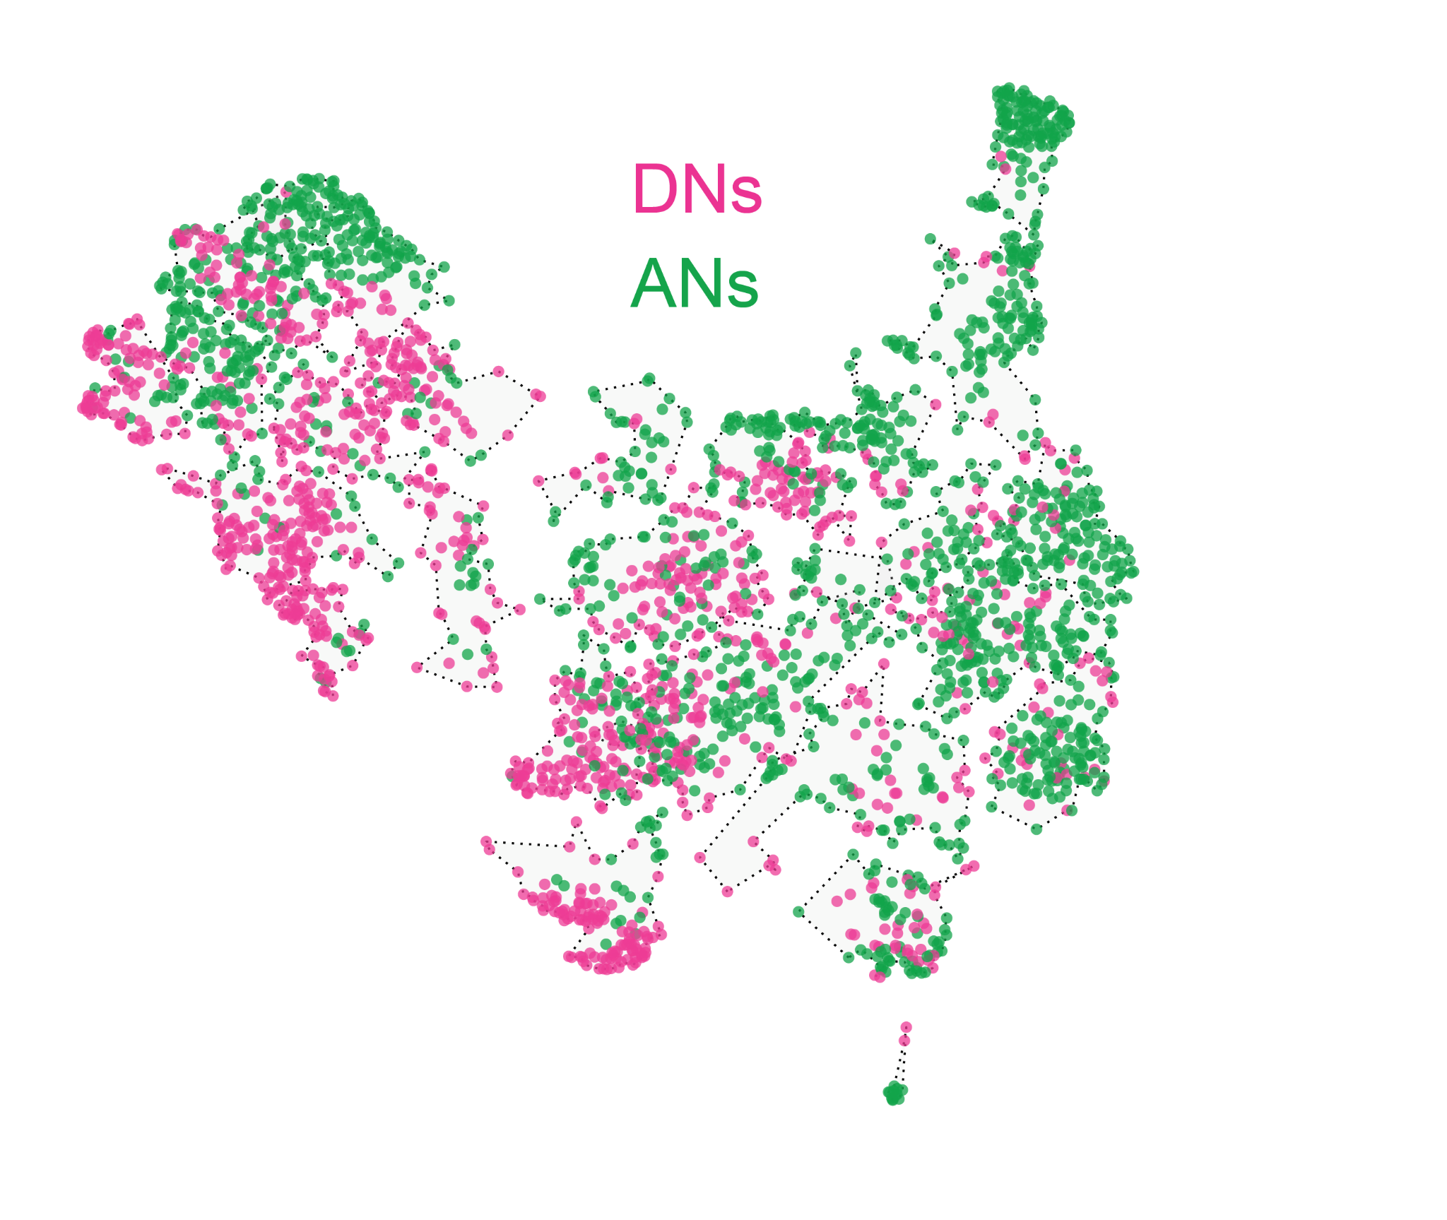
ascending and descending neurons link sets of sensors to sets of effectors
descending neurons
ascending neurons
Notes:
Here, we’ve embedded all the ANs and DNs based on their direct pre- and postsynaptic connections. Then, on top, can overlay influence from different sets of sensory neurons

Slide 32
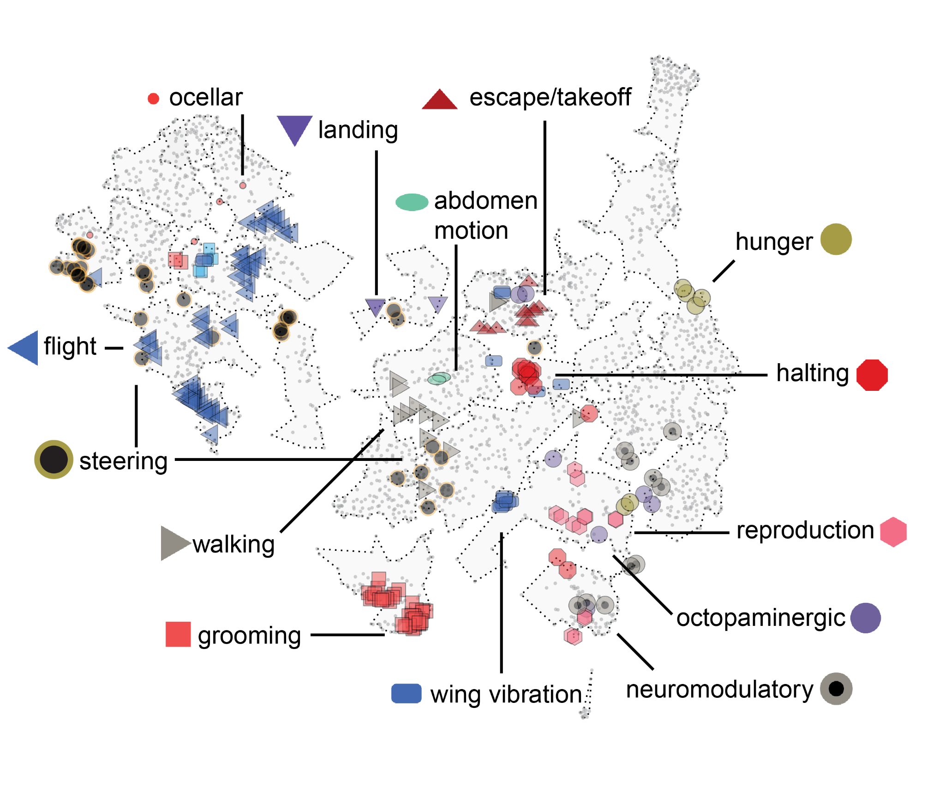
previously characterized ascending and descending neurons cluster together
Notes:
We can also map ANs and DNs whose function has been previously described in the literature onto this embedding. Those with similar function cluster together in this embedding.
We can use this info about known functions of some of these cells as well as the patterns of sensor and effector influence to assign putative functions to cells in each part of this space

Slide 33
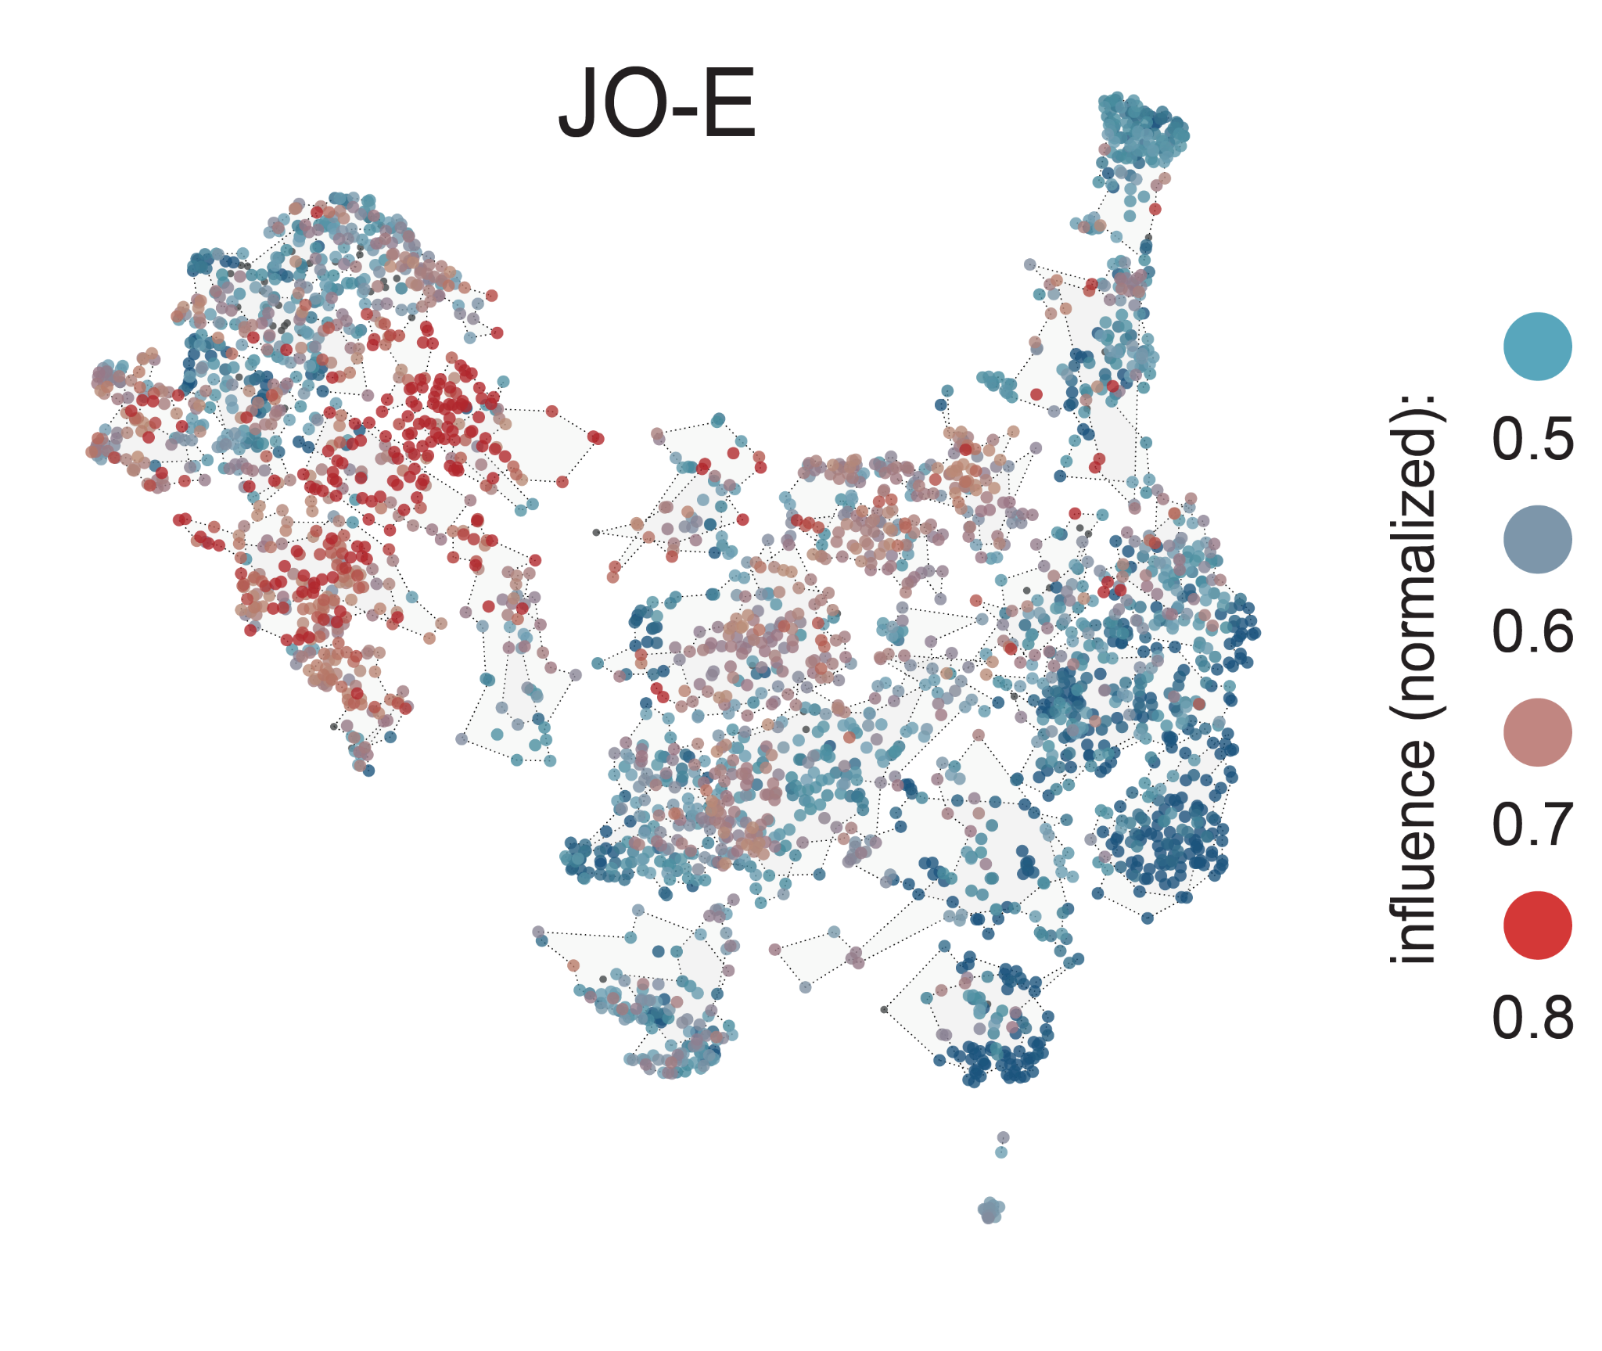
ascending and descending neurons link sets of sensors to sets of effectors
influence from:
JO-E
antenna
mechanosensory
Notes:
For example, here’s the influence from the E type Johnson’s organ neurons, which are a subclass of mechanosensors that report antennal movement. Particular ANs and DNs get strong influence

Slide 34
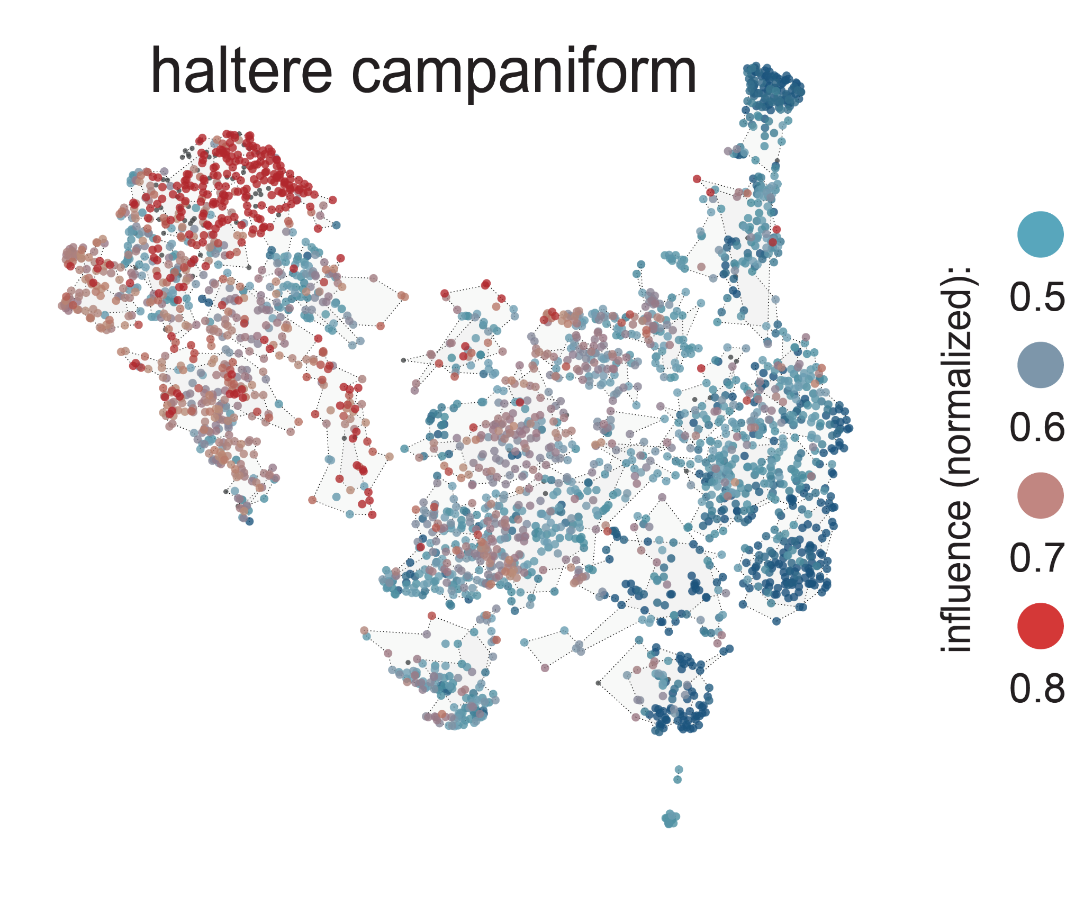
ascending and descending neurons link sets of sensors to sets of effectors
influence from:
haltere
mechanosensory
Notes:
Overlapping but distinct set of ANs/DNs get their strongest influence from another type of mechanosensor, the campaniform sensilla of the haltere

Slide 35
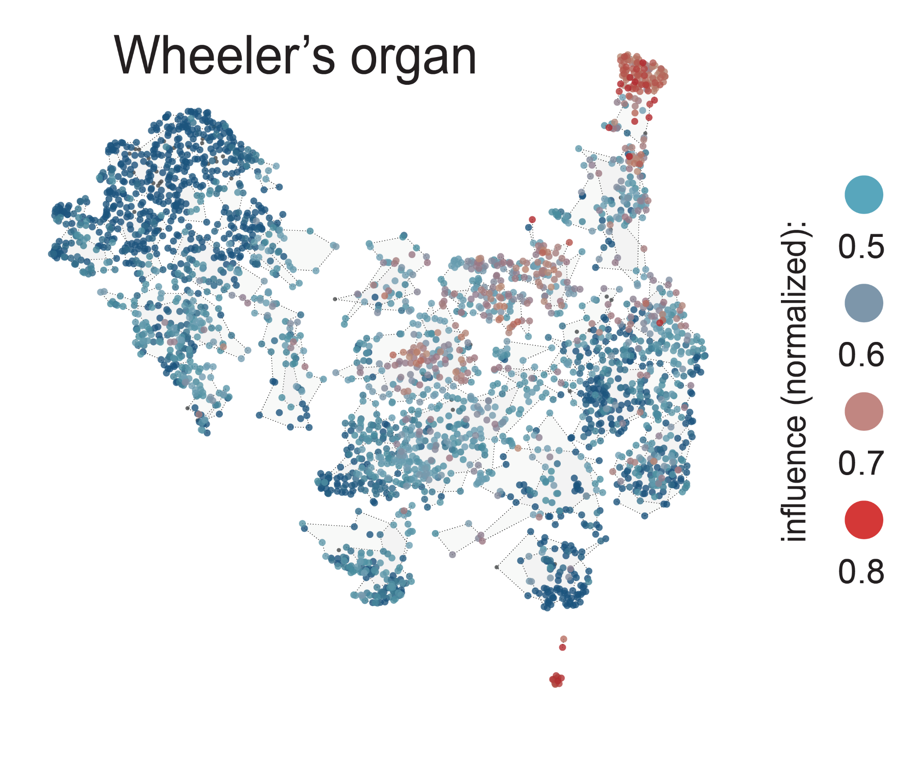
ascending and descending neurons link sets of sensors to sets of effectors
influence from:
Wheeler’s organ
abdominal
mechanosensory
Notes:
Mechanosensory Wheeler’s organ again influences overlapping but distinct set

Slide 36
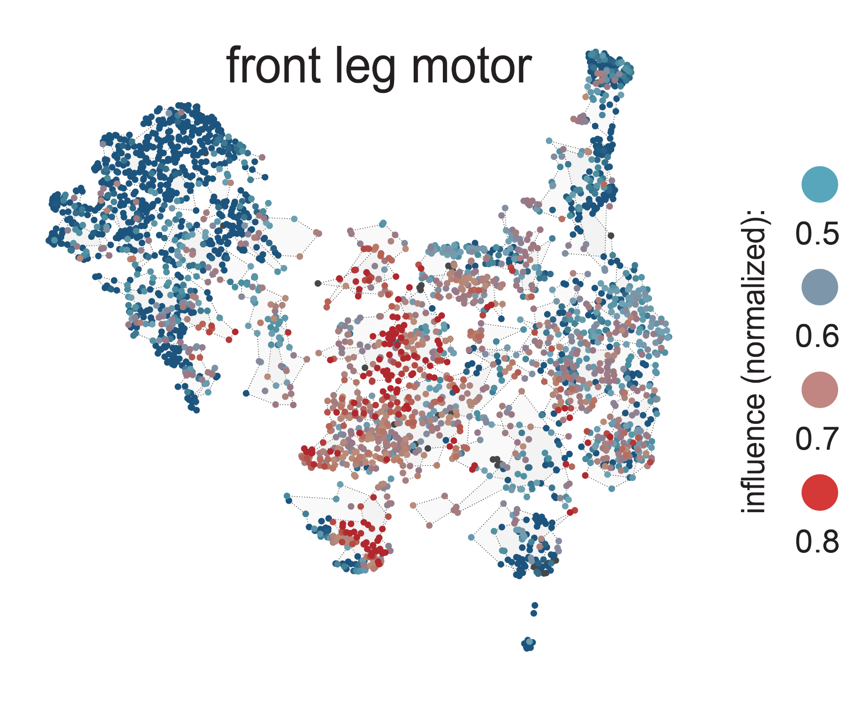
ascending and descending neurons link sets of sensors to sets of effectors
influence to:
front leg motor
Notes:
We can also look at how these ANs and DNs influence different effectors. Again, different cells have distinct influence onto different effector types

Slide 37
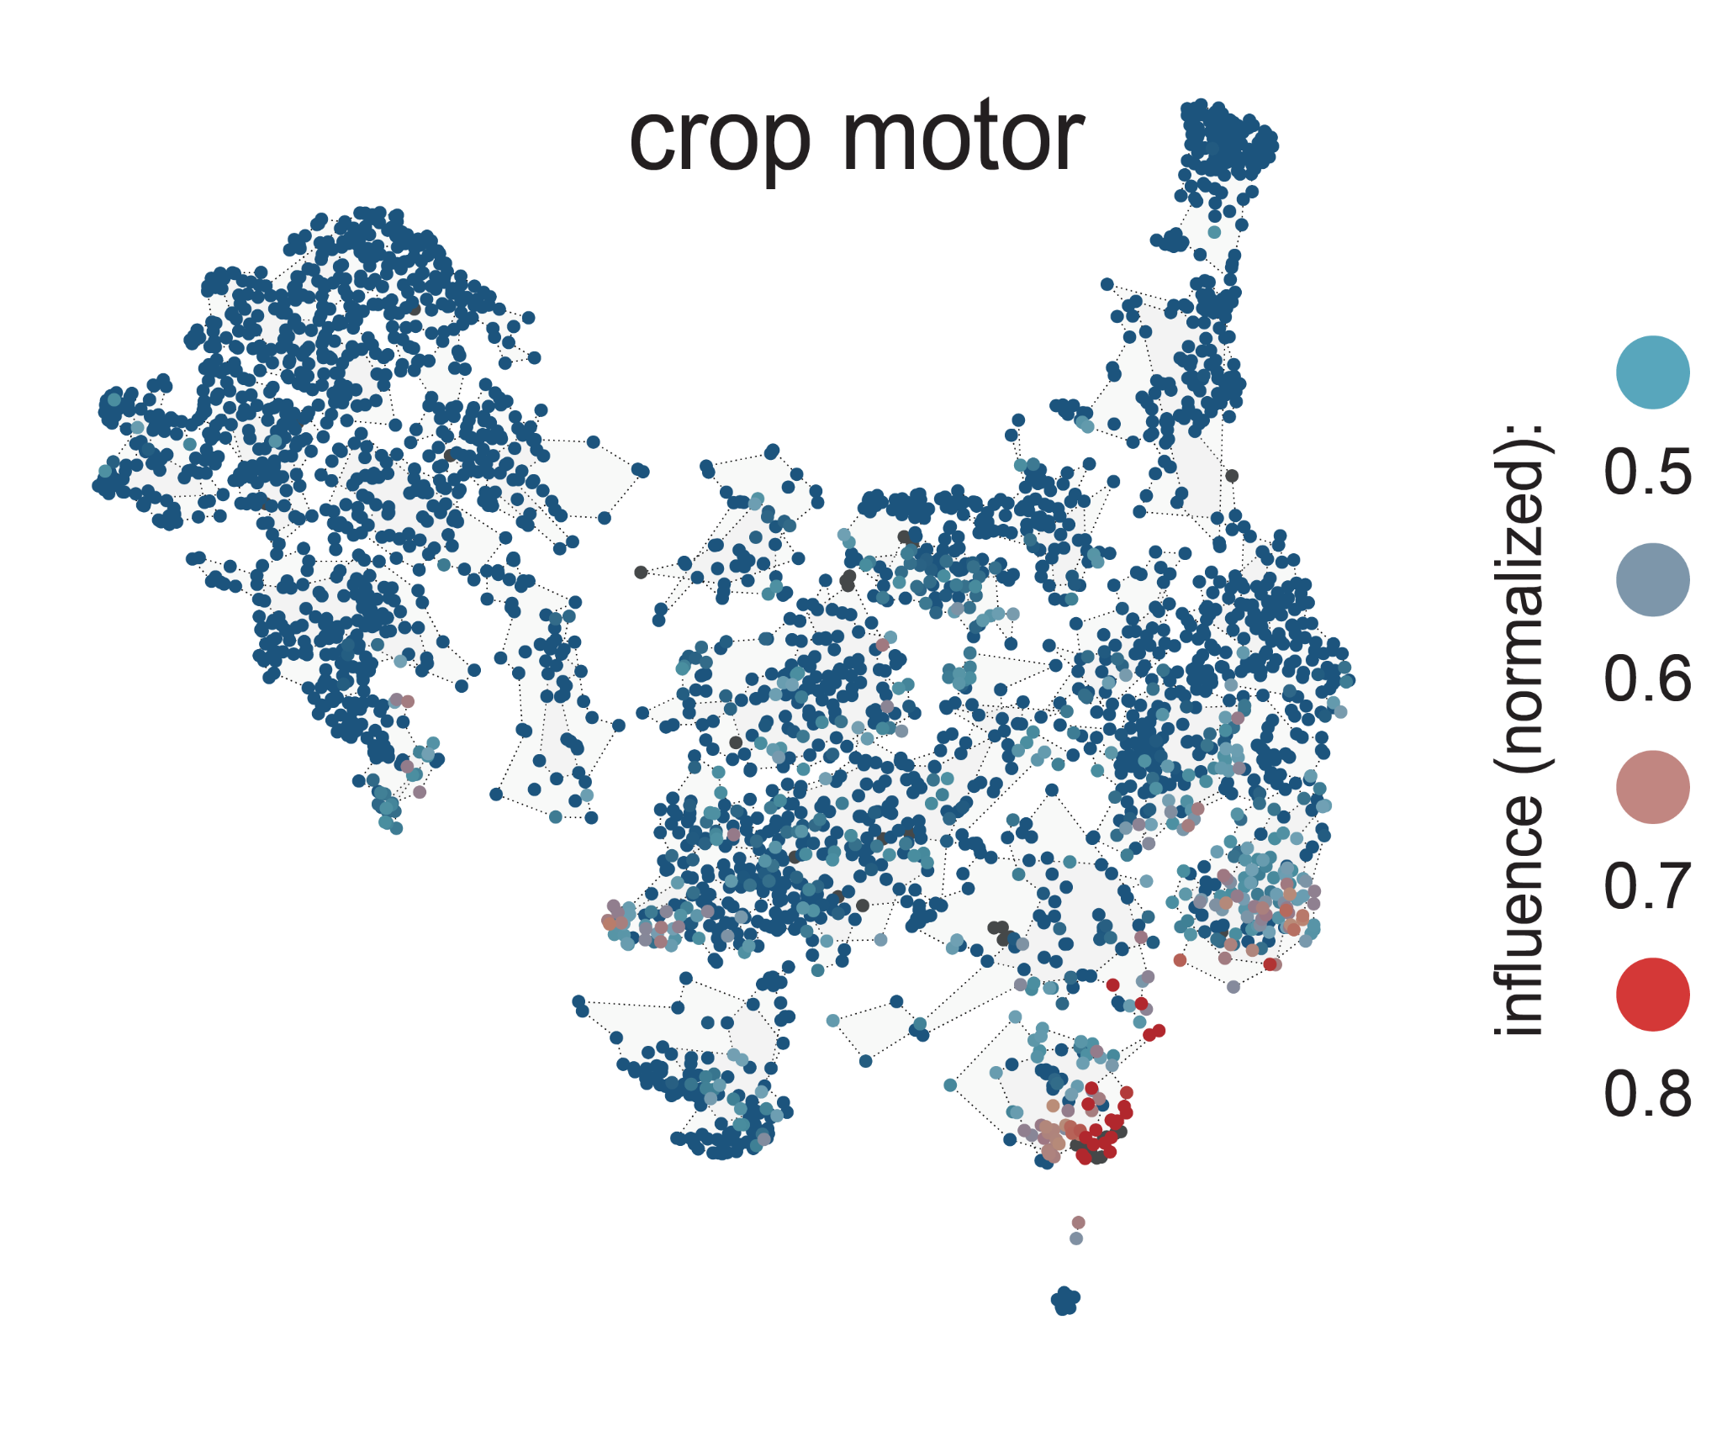
ascending and descending neurons link sets of sensors to sets of effectors
influence to:
crop motor
(ingestion)

Slide 38
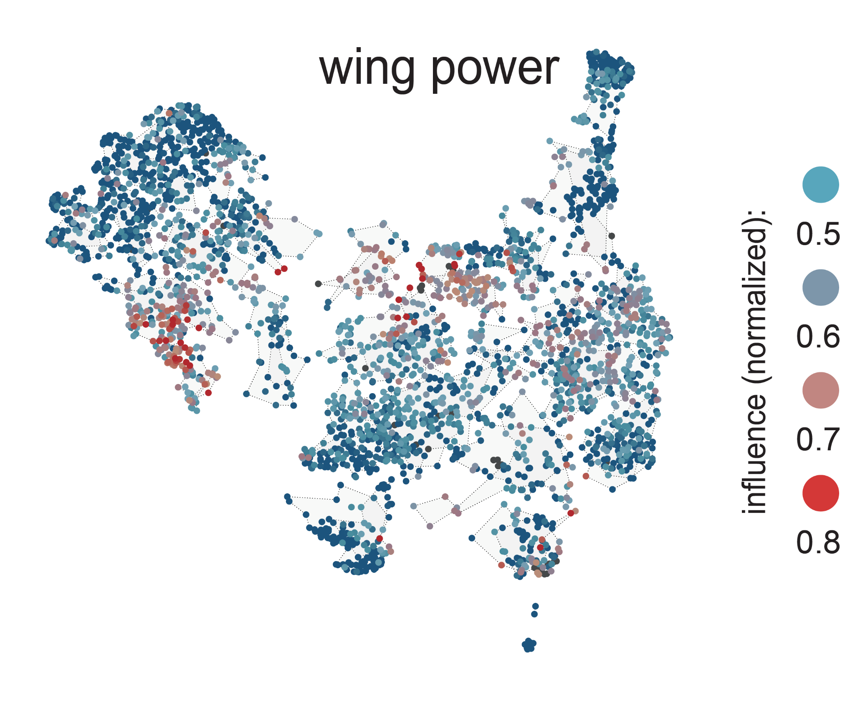
ascending and descending neurons link sets of sensors to sets of effectors
influence to:
wing motor
(power)
Notes:
Thus, ANs and DNs link sets of sensors to sets of effectors.

Slide 39
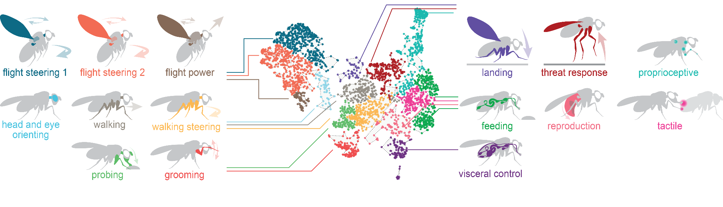
ascending and descending neuron superclusters associate with specific behaviors
Notes:
Here are the superclusters of ANs and DNs we’ve defined and the functions we’ve assigned them. For example, flight power and flight steering contain the known flight-related neurons but they’re separable based on their sensor and effector influences, especially with the flight power ANs/DNs specifically influencing the motor neurons controlling the indirect flight muscles that power the wings

Slide 40
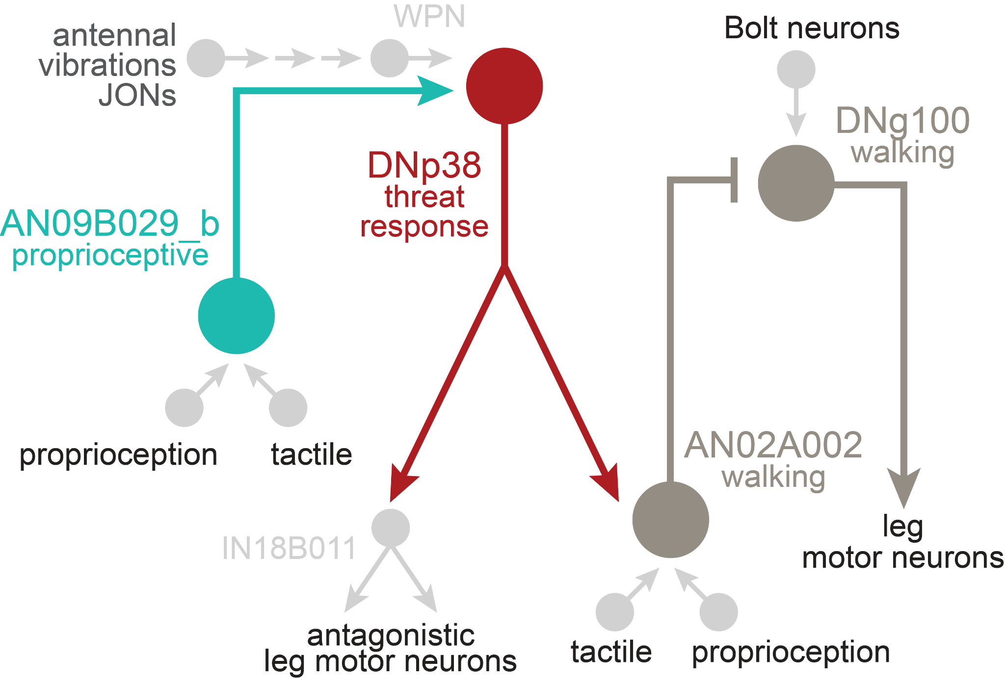
ascending and descending neuron superclusters influence each other
Notes:
Here’s a summary of those interactions. Many superclusters influence each other. But important to note that it’s not all-to-all. Also, often directional.
At the level of specific cells, we can see some of these cross-module interactions. For example, this AN of the proprioceptive supercluster provides input to a DN of the threat response supercluster, which then goes on to input onto an AN of the walking supercluster. This particular case, threat response DN likely drives a defensive posture by co-activating antagonistic leg muscles. In response to mechanosensory input through another supercluster. And simultaneously inhibit walking, which would be counter to a stabilizing defensive posture.

Slide 41
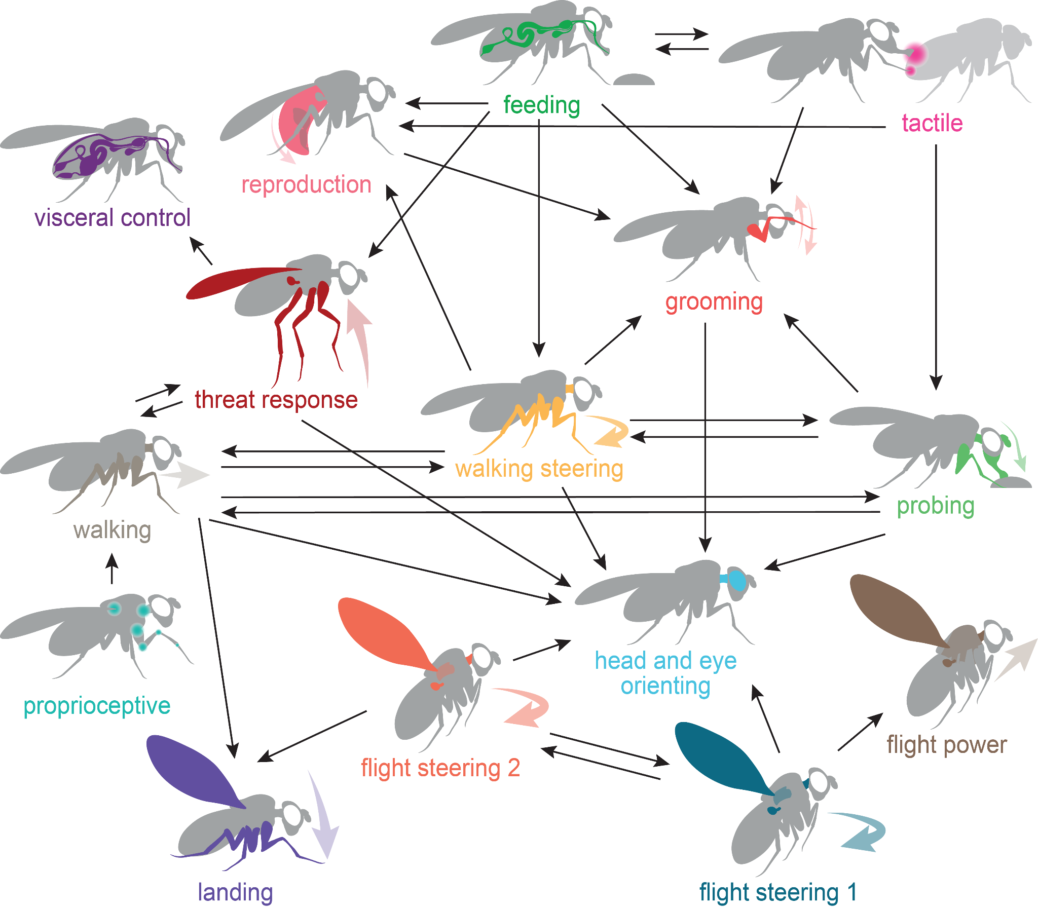
ascending and descending neuron superclusters influence each other
Notes:
Here’s a summary of those interactions. Many superclusters influence each other. But important to note that it’s not all-to-all. Also, often directional.
At the level of specific cells, we can see some of these cross-module interactions. For example, this AN of the proprioceptive supercluster provides input to a DN of the threat response supercluster, which then goes on to input onto an AN of the walking supercluster. This particular case, threat response DN likely drives a defensive posture by co-activating antagonistic leg muscles. In response to mechanosensory input through another supercluster. And simultaneously inhibit walking, which would be counter to a stabilizing defensive posture.

Slide 42
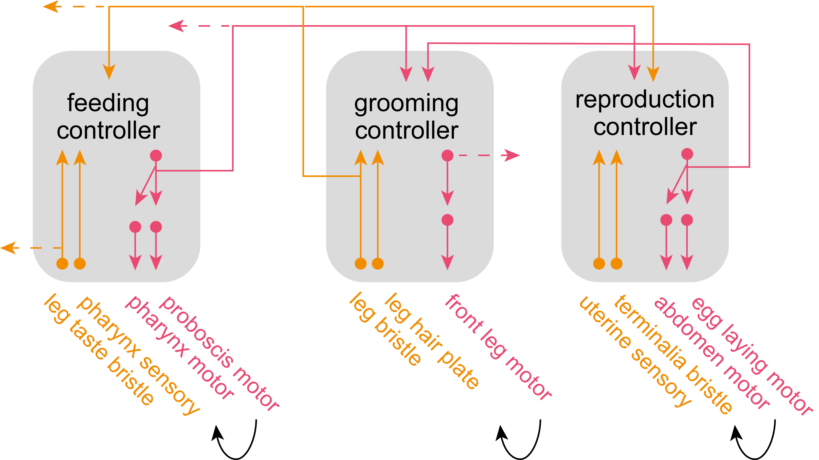
low-level sensor-effector units are chained by long-ranged connections
Notes:
Here, we’ve embedded all the ANs and DNs based on their direct pre- and postsynaptic connections. Then, on top, can overlay influence from different sets of sensory neurons

Slide 43
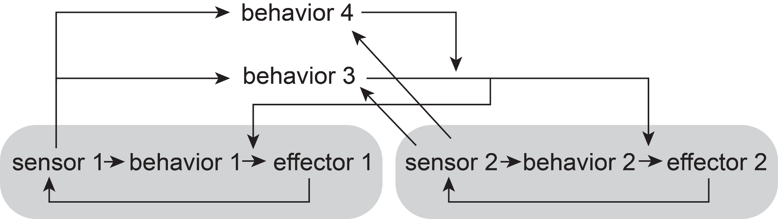
the arrangement of ascending and descending superclusters is analogous to a subsumption architecture
Notes:
The arrangement we’ve described for sensor to effector transforms through ANs and DNs is analogous to the subsumption architecture from robotics. In this framework, there are local loops that perform specific behaviors with a set of sensors and effectors, here behaviors 1 and 2. But then, other behaviors can subsume these local loops to utilize their functions or override them to generate a different output. Here, behavior 3 subsumes 1 and 2 based on input from the sensors. And this can be hierarchical, so behavior 4 subsumes the other 3.
The local sensor-effector loops we see in the fly connectome could be thought of as these low level loops. The ANs and DNs that connect local loops across the body perhaps subsume them and define new behavioral motifs. And the influences between superclusters of ANs and DNs are similar to the hierarchical arrangement to define additional behaviors.

Slide 44
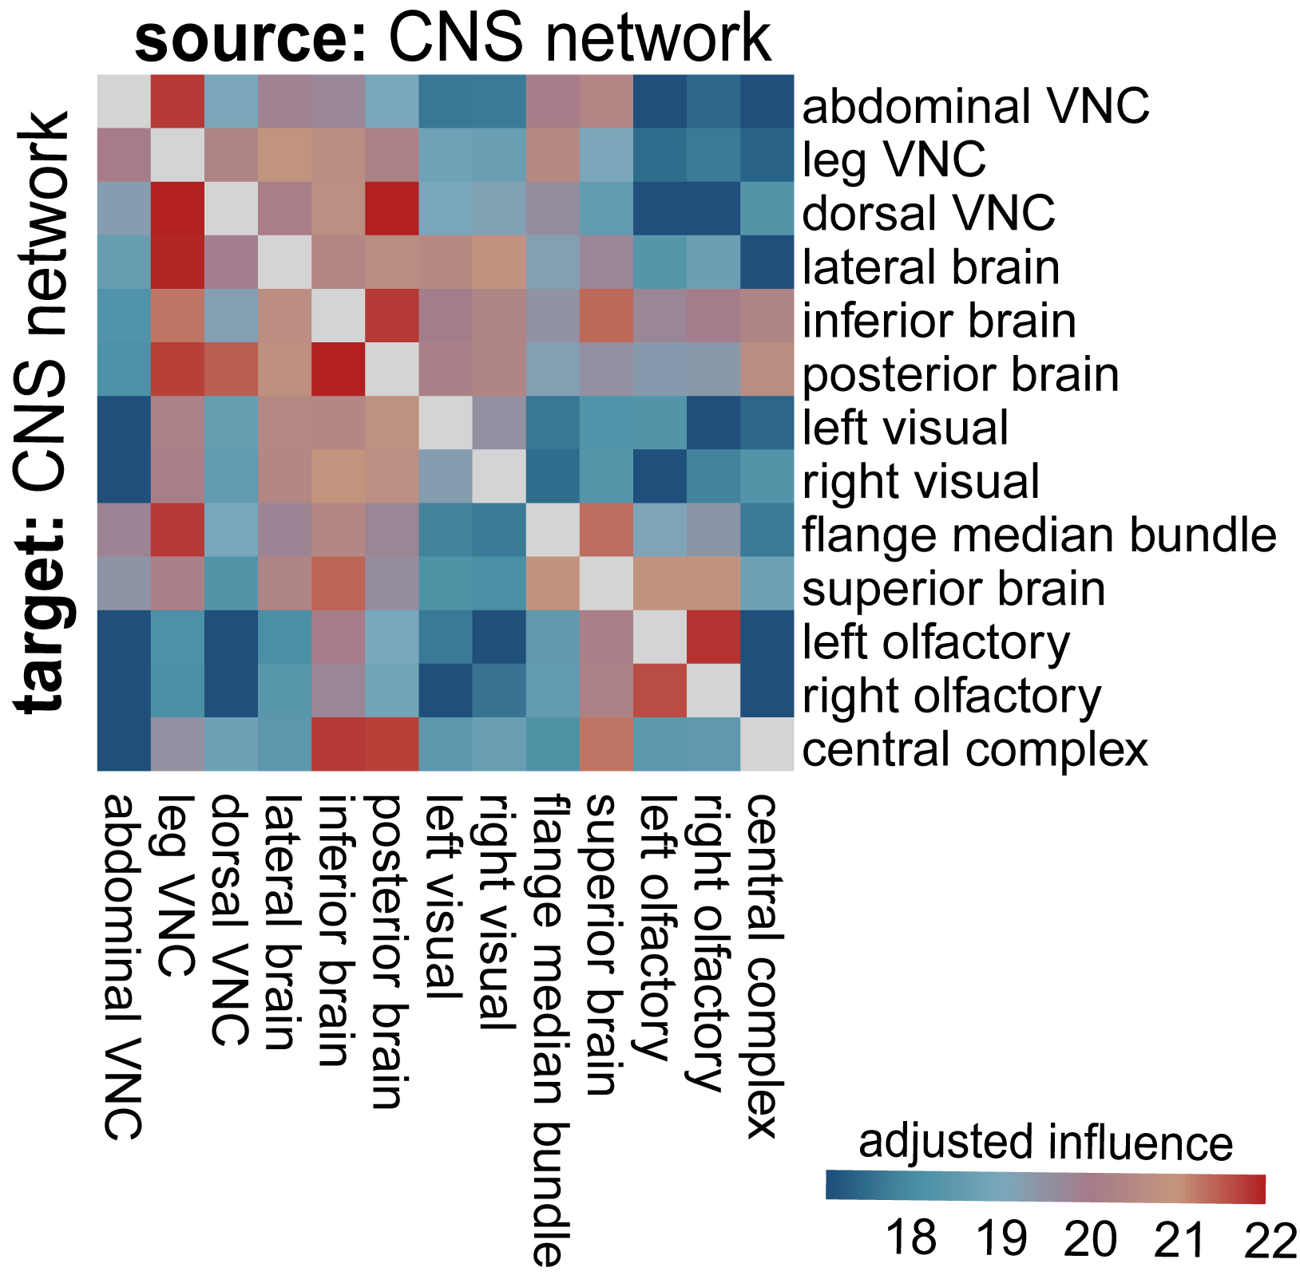
classical "central controllers" are not very influential
Notes:
The arrangement we’ve described for sensor to effector transforms through ANs and DNs is analogous to the subsumption architecture from robotics. In this framework, there are local loops that perform specific behaviors with a set of sensors and effectors, here behaviors 1 and 2. But then, other behaviors can subsume these local loops to utilize their functions or override them to generate a different output. Here, behavior 3 subsumes 1 and 2 based on input from the sensors. And this can be hierarchical, so behavior 4 subsumes the other 3.
The local sensor-effector loops we see in the fly connectome could be thought of as these low level loops. The ANs and DNs that connect local loops across the body perhaps subsume them and define new behavioral motifs. And the influences between superclusters of ANs and DNs are similar to the hierarchical arrangement to define additional behaviors.

Slide 45
subsumption architecture
hierarchical control
sensation
state
sensation
behaviour 1
p
effectors
integration
body parts
p
state
layers
behaviour 1I
effectors
action selection
behaviour III
p
effectors
common
effectors
effectors
effectors
effectors

Slide 46




Rachel Wilson
Jan Drugowitsch
Helen
Yang
Zaki
Ajabi
+ Sophia Renauld, Mohammed Abdal Monium Osman, Matthew F. Collie, Jingxuan Fan, Diego A. Pacheco

Slide 47








the BANC is ready for use

Slide 48
acknowledgements
authors
Alexander Shakeel Bates*, Jasper S. Phelps*, Minsu Kim*, Helen H. Yang*, Arie Matsliah, Zaki Ajabi, Eric Perlman, Kevin M. Delgado, Christopher K. Salmon, Jay Gager, Benjamin Silverman, Sophia Renauld, Mohammed Abdal Monium Osman, Matthew F. Collie, Jingxuan Fan, Diego A. Pacheco, Yunzhi Zhao, Janki Patel, Wenyi Zhang, Laia Serratosa Capdevilla, Ruairí J.V. Roberts, Eva J. Munnelly, Nina Griggs, Helen Langley, Borja Moya-Llamas, Ryan T. Maloney, Szi-chieh Yu, Amy R. Sterling, Marissa Sorek, Krzysztof Kruk, Nikitas Serafetinidis, Serene Dhawan, Tomke Stürner, Finja Klemm, Paul Brooks, Ellen Lesser, Jessica M. Jones, Sara E. Pierce-Lundgren, Su-Yee Lee, Yichen Luo, Andrew P. Cook, Theresa H. McKim, Emily C. Kophs, Tjalda Falt, Alexa M. Negrón Morales, Austin Burke, James Hebditch, Kyle P. Willie, Ryan Willie, Sergiy Popovych, Nico Kemnitz, Dodam Ih, Kisuk Lee, Ran Lu, Akhilesh Halageri, J. Alexander Bae, Ben Jourdan, Gregory Schwartzman, Damian D. Demarest, Emily Behnke, Doug Bland, Anne Kristiansen, Jaime Skelton, Tom Stocks, Dustin Garner, Farzaan Salman, Kevin C. Daly, Anthony Hernandez, Sandeep Kumar, Sven Dorkenwald, Forrest Collman, Marie P. Suver, Lisa M. Fenk, Michael J. Pankratz, Gregory S.X.E. Jefferis, Katharina Eichler, Andrew M. Seeds, Stefanie Hampel, Sweta Agrawal, Meet Zandawala, Thomas Macrina, Diane-Yayra Adjavon, Jan Funke, John C. Tuthill, Anthony Azevedo, H. Sebastian Seung, Benjamin L. de Bivort, Mala Murthy, Jan Drugowitsch, Rachel I. Wilson*, Wei-Chung Allen Lee*
funding
NIH
NSF
MRC
HHMI
New York Stem Cell Foundation
Deutsche Forschungsgemeinschaft
Max Planck Society
Alice and Joseph Brooks Fund
Shanahan Family Foundation
Smith Family Odyssey Grant
Harvard/MIT Joint Research Grant

Slide 49
acknowledgements
proofreaders
Jenny Esteban Abelo, Rimalyn Enopli Silay, Anthony Ralph Piccio, Renzo D. Requintina, Micah Colinares Molinas, Shaina Rose Araneta, Jazel R. Digamon, Carine E. Estrella, Marlon Kedet Roda, Michael Manayaga Mates, David Benjamin D. Conquilla, Romilyn Bardonido, Alvin Josh Mandahay, Rey Mark Asares, Brion Glee Baliña Gloria, Aleanne May Hopkins, Jessa Calambro, Christine Joy Maquilan Tac- an, Cj Christine Cordova Tan, Cj Pilapil, Lea Lovely Joy Jimenez Pelingon, Mary Rose Golez, Prince Lloyd Sy Cagampang, Jacquilyn Laude, Ehreca Mae Jongco Pojio, Jayanne Biodes Mayormita, Mike Quibo Tambuco, Madiemie Inguito, Cedrick Earl Bernasol, Roden Rey Nuiz Dizon, Francis Rainer Lindo, Noroddin Balambag, Cathy Pilapil, Tutor, Larben Milagrosa, Clyde Albero, Cesar Jun M. Subtenente, Elison Rovic Monte, Sherwin Salem, Estephani A. Lim, Enriq Gerald Pacaldo, Juliane Maquiling Bulaclac, Yna Bustria Jallorina, Catherine Gasi Colminas, Michael Carlo M. Pabroquez, Jonalyn S. Revilleza, Nina Mae Dulaca, Marchan Manaytay, Rommel Roa, Glenda Malda Dawa, Baby Jane Getizo, April Grace Delantes Alagaban, Krystel Joy Domingo, Mark Lester Avila, Nelsie Panes, Dwight Jumaag, Hugh Ven Kyle Tecson, Jansen Seguido, James Nicle Cano, John David Asis, Althea Lou Alojipan Aligria, Philip Ampo, Mary Grace Ybanez, Charmelyn Urboda, Vanessa C. Dal, Rhosly Jay Bumaya, Regine Salem, Jan Marinie Ferraren, Mark Lester Caño, Joseph Enoc Roilo, Aljon Lastimoso, Romelita Maignos, Kendrick Joules Vinson, Hella Jones Dulay, Celso Gonzales, Raffy Acosta, Irish Quijada Bonso, Johnclyde Saguimpa, Wilbur Hernando De la Torre, Mark Lloyd Pielago, Clerk Derecho, Jaypee Balco, Remer Tancontian, Allien Mae Gogo, Joshua Bañez, Nashra Hadjerol, Jeslie Labaya Bongcales, Chereb Martinez, Ianloyd B. Polinar, Jeanity Dominguez, Charlote B. Solana, Queendolyn Pama, John Niño M. Ugdang, Melcris Damasco, Marianne Marie Villarba, Edrian R. Navaja, Janice Salocot, Daril Bautista, James Andrew A. Campos, Elanur Jimlani Acmad, Jet Dolorosa, Zairene Lenizo, Rey Adrian Candilada, Logic Domme Sauro Ybañez, Mark Clint Encallado, Jovie Cano, Anna Verbe, Gabriel A. Nieves-Sanabria, Devon Jones, Zijin Huang, Sofia Pinto, Celia David, Omaris Y. De Pablo-Crespo, Emily Ye, Wolf Huetteroth, Zequan Liu, Fernando J. Figueroa Santiago

